Slide 1
FX006-2018-015 SIV Training

Slide 2
CRMG Contact Information
Blinded CRA
Blinded LCRA
Gina Baldyga
g.baldyga@crmg-usa.com
413-821-0022
Unblinded CRA
Unblinded LCRA
Diane Bedor
D.bedor@crmg-usa.com
413-821-0022

Slide 3
Flexion Team
Blinded
Robert Arbeit, MD Medical Monitor
Lorena Prekulaj Clinical Trial Manager
Margaret Szerszunowicz In-House Clinical Research Associate
Kaliela Osha Clinical Project Coordinator
Bob Chinchillo Data Manager
Jennifer Bermont Data Manager (back-up)
Unblinded
Danielle Price Clinical Supply (unblinded)

Slide 4
Site Communication
Assigned unblinded monitor will be first point of contact for unblinded staff and study related issues pertaining to study drug and injection procedure
Assigned blinded monitor will be the first point of contact for blinded staff and study related issues pertaining to ISF, screening and enrollment
Safety Issues should be directed to Medical Monitor through the General Log.
EDC technical issues should be relayed to Axiom EDC Helpdesk.
Contact information provided in regulatory binder.

Slide 5
Study Timelines
US Site SIVs | Late Nov 2018 to early March 2019
First Patient Screened | Week of Dec 3rd 2018
First Patient Enrolled | By Dec 21st 2018
Last Patient Enrolled | June 2019
Last Patient Last Visit | March 2020
Database lock | March 2020
Notes:
Stress the importance of completing enrollment by June 2019 (sites with longer start up timelines may have less time than others)

Slide 6
FX006 Background & Clinical Studies
FX006-2018-015 SIV Training

Slide 7
Objectives in designing an extended-release IA CS
Extended joint residency time in the synovial fluid for efficacy
Minimize plasma exposure to reduce systemic side-effects
Synovial concentration
Plasma concentration
IA, intra-articular; CS, corticosteroids

Slide 8
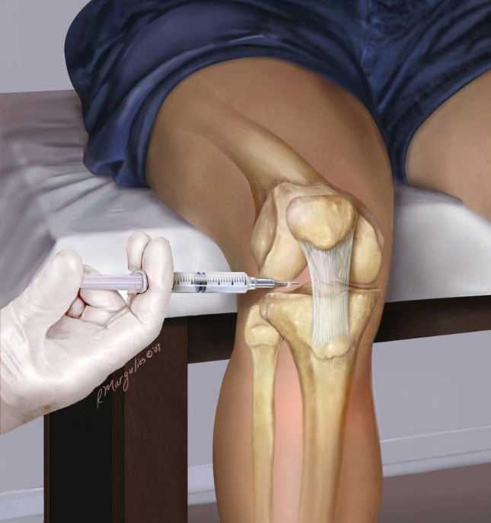

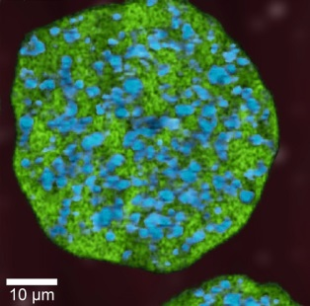
ZILRETTA: The First and Only FDA-Approved Extended Release, Intra-articular Therapy for OA Knee Pain
ZILRETTA is a non-opioid therapy which utilizes triamcinolone acetonide (TA) embedded in Flexion’s proprietary PLGA microsphere formulation to:
  Provide proven pain relief over 12 weeks, with a safety profile similar to placebo.
  Deliver extended release of medicine at the source of the patient’s pain
  Provide significant therapeutic benefit through targeted delivery
  ZILRETTA PK/PD studies showed:
  Documented Synovial Fluid concentrations through 12 weeks
  Peak plasma concentrations were 11-fold lower than immediate release TA
  Minimal effects on blood glucose vs a standard steroid in Type 2 diabetes patients with knee OA 72 hours post dosing (primary endpoint)
Illustration by Robert Margulies, M.S.
Controlled diffusion of TA
via nano-channels
Green: PLGA matrix
Blue: TA crystals
¹PLGA: poly(lactic-co-glycolic acid)

Slide 9
Clinical Experience with FX006
Study Number/Indication | Objectives | Study Design | Sample Size | Treatment Arms
FX006-2011-002 Phase 2 Knee OA | Pharmacodynamic effects Plasma PK Safety & tolerability Synovial PK (exploratory) | Multi-center, double-blind, randomized (1:1:1:1), parallel-group, active comparator single IA injection 6 wk follow up | 24 | 10 mg FX006 40 mg FX006 60 mg FX006 40 mg TCA IR
FX006-2011-001 Phase 2b Knee OA | Efficacy Plasma PK Safety & tolerability | Multi-center, double-blind, randomized (1:1:1:1), dose-ranging, parallel-group, active comparator single IA injection 12 wk follow up | 229 | 10 mg FX006 40 mg FX006 60 mg FX006 40 mg TCA IR
FX006-2013-005 Phase 2 Knee OA | Synovial PK Plasma drug concentrations Safety & tolerability | Multi-center, open-label, sequential assignment single IA injection 12 to 20 wk follow-up | 50 | 10 mg FX006 40 mg FX006 40 mg TCA IR
FX006-2014-006 Phase 2b Knee OA | Efficacy Safety & tolerability | Multi-center, double-blind, randomized (1:1:1), dose-confirmation, parallel-group, placebo-controlled single IA injection 24 wk follow up | 310 | 16 mg FX006 32 mg FX006 Normal saline
CONFIDENTIAL
9
Notes:
Studies are listed as reference; refer sites to the IB.
Do not read through this slide but provide a high level of the studies conducted to date

Slide 10
Clinical Experience with FX006 (cont.)
Study Number | Objectives | Study Design | Sample Size | Treatment Arms
FX006-2014-008 Phase 3 Knee OA | Efficacy Safety & tolerability | Multi-center, double blind, randomized (1:1:1), parallel-group, active comparator, placebo controlled single IA injection 24 wk follow- up | 486 | 32 mg FX006 40 mg TCA IR Normal saline
FX006-2015-009 Phase 2 Knee OA | Plasma PK Synovial PK Safety & tolerability | Multi-center, open-label, sequential assignment single IA injection up to 20 week follow up | 81 | 32 mg FX006 40 mg TCA IR
FX006-2015-010 Phase 2 Knee OA pts with Type 2 diabetes | Blood glucose effect Safety & tolerability | Multi-center, double blind, randomized (1:1), parallel group, single IA injection 6 week follow up | 33 | 32 mg FX006 40 mg TCA IR
FX006-2016-011 Phase 3b Knee OA | Safety & tolerability of repeat injection Exploratory efficacy | Multi-center, open-label, single arm Up to 2 IA injections of FX006 up to 52 weeks follow up | 208 (179 with repeat injection) | 32 mg FX006
CONFIDENTIAL
10

Slide 11
Clinical Experience with FX006 (cont.)
Study Number | Objectives | Study Design | Sample Size | Treatment Arms
FX006-2017-012 Bilateral knee OA Phase 2 | Plasma PK Safety & tolerability | Multi-center, double blind, randomized (1:1), parallel group, single IA injection 6 week follow up | 24 | 32 mg FX006 40 mg TCA IR
FX006-2017-013 Hip and Shoulder OA Phase 2 | Plasma PK Safety & tolerability | Multi-center, double blind, randomized (1:1), parallel group, single IA injection 12 week follow up | 24 per joint | 32 mg FX006 40 mg TCA IR
FX006-2017-014 Knee OA Phase 2 | Measures of inflammation Efficacy Bone area and cartilage thickness | Multi-center, open-label, single arm single IA injection 24 week follow up | 100 | 32 mg FX006
CONFIDENTIAL
11

Slide 12
FX006 Pharmacokinetics (PK)
CONFIDENTIAL

Slide 13
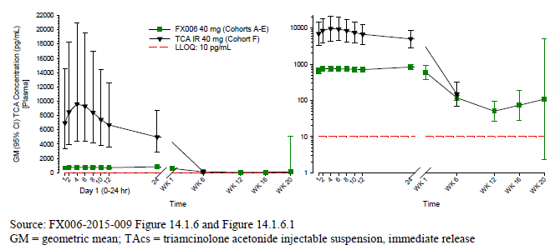
Plasma (Systemic) PK in Patients with OA of the Knee
Overall, FX006 displayed a favorable plasma PK profile relative to TAcs.
  PK observations in Study FX006-2015-009 showed a controlled and stable release of TA from PLGA microspheres into synovial tissues.
  Concentrations remained high relative to plasma concentrations ≥ 12 weeks
  Relative to TAcs, FX006 32 mg produced substantially lower peak plasma and systemic exposure to TA.

Slide 14
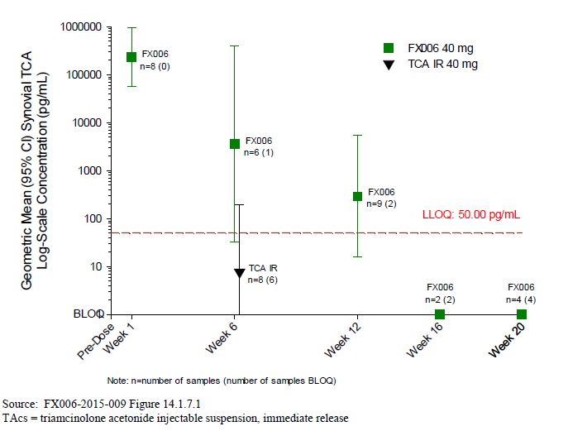
Synovial Fluid (Local) PK in Patients with OA of the Knee
FX006 prolonged residence of TA in the joint while minimizing systemic exposure to TA.

Slide 15
FX006 Pharmacodynamics (PD)
CONFIDENTIAL

Slide 16
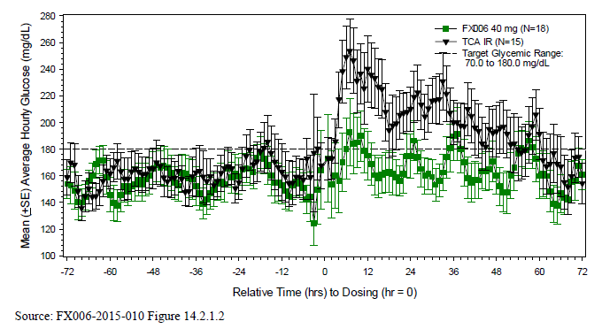
FX006-2015-010: PD in Patients with OA of the Knee
  Statistically significant (p=0.0452) reduction in blood glucose elevation relative to TAcs over 72 hour period after IA injection.
  Over the 15 day post injection glucose monitoring period, blood glucose levels associated with FX006 remained at levels similar to or lower than those produced by TAcs.
  Data suggest that FX006 may be administered with minimal disruption of glycemic control in patinents with type 2 diabetes

Slide 17
FX006 Efficacy
CONFIDENTIAL

Slide 18
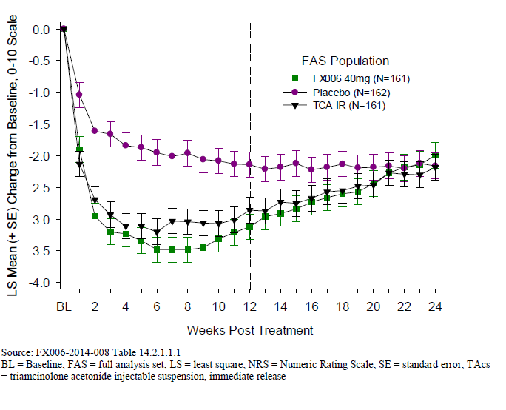
Clinical Studies: Efficacy in Patients with OA of the Knee
Results from Phase 3 (-008) study demonstrated that FX006 resulted in rapid and sustained pain reduction relative to placebo (p < 0.0001).

Slide 19
Clinical Studies: Efficacy in Patients with OA of the Knee (cont.)
Analyses of OA-specific secondary endpoints showed an advantage of FX006 32 mg over placebo.
  Statistically significant improvement in WOMAC A (pain), B (stiffness), and C (function) subscale scores and Knee Injury and Osteoarthritis Outcome Score Quality of Life (KOOS QoL), with significant differences at Weeks 4, 8, and 12 (at each time point P ≤ 0.0038).
  Other pre-specified analyses, including PGIC, CGIC, OMERACT-OARSI responders, patients experiencing at least 50% improvement in ADP and reduction of rescue medication, were statistically significant relative to placebo through at least Week 12.
Results of the comparison between FX006 32 mg and TAcs showed an advantage in favor of FX006 32 mg at Week 12 on those OA-specific measures of WOMAC A, B and C , as well as KOOS QoL, but a less notable separation was seen on ADP at Week 12 (see previous slide)

Slide 20
FX006 Safety
CONFIDENTIAL

Slide 21
Clinical Studies: Safety in Patients with OA of the Knee
Evaluation of 687 patients treated with a single IA injection of FX006 at any dose in the FX006 clinical studies suggests that it was well tolerated with systemic and local safety profiles similar to those to TAcs and placebo.
Consistent safety data:
  TEAEs reported was similar across groups
    FX006 46.0%; placebo 49.2%; TAcs 51.0%
  Most TEAEs were mild or moderate (Grade 1 or 2).
  Rate of SAEs was low and similar across groups
    FX006 1.9%; placebo 1.1%; TAcs 2.3%
No drug related SAEs or deaths across all studies.

Slide 22
Clinical Studies: Safety in Patients with OA of the Knee
Most common TEAEs in FX006-treated patients:
  Arthralgia (Joint pain) 9.8% (n=67)
  Headache 5.4% (n=37)
  Upper respiratory tract infection 3.1% (n=21)
  Joint swelling 2.8% (n=19)
  Contusion and back pain 2.3% (n=16)
  Nasopharyngitis 2.2% (n=15)
CONFIDENTIAL
22

Slide 23
FX006 Safety as Seen by X-Ray Assessment Analysis
At Week 24, Qualitative Assessments were performed by a central reader of:
  Joint Space Narrowing (JSN)
  Subchondral Bone Changes
  Osteonecrosis
  Insufficiency Fracture
  Additional Observations
Findings for FX006-treated patients:
  Overall rate of JSN between baseline and Week 24 was low and similar between groups (% with 1 grade increase: FX006 5.0%; placebo 4.1%; TAcs 3.5%)
  No FX006-treated patient had X-ray evidence of treatment-emergent insufficiency fracture, subchondral bone changes or osteonecrosis at Week 24.
CONFIDENTIAL
23

Slide 24
FX006-2018-015 Protocol
A Randomized, Double-blind, Placebo-controlled, Parallel-group Study to Evaluate the Efficacy and Safety of FX006 in Patients with Hip Osteoarthritis

Slide 25
Site Overview and Enrollment Expectations
Study Centers: Multiple centers, approximately 40-50 sites
40 US Sites, Possibly 5 CAN Sites
Study Phase: Phase 3
Number of Patients: 440 patients (n=220/arm)
Study enrollment expected to complete by June 2019.
Site enrollment max will be 40 patients/site.
Sites are expected to enroll 2-4 patients per month.

Slide 26
Study Design
A multi-center, randomized, double-blind, placebo-controlled, parallel-group study in patients with hip OA
Approximately 440 patients randomized to one of two treatment groups (FX006 or saline placebo ) in a 1:1 ratio, and treated with a single IA injection of either 32 mg FX006 or normal saline.
  An estimated 220 patients will receive a second injection in the open-label phase.
FX006 or saline placebo will be administered as a single IA injection with a 12-week follow-up period in the double-blind phase.

Slide 27
Study Design (Continued)
Two Phases to this study:
Double Blind Phase (12 Weeks)
Open Label Extension Phase (OLE), which can start at Week 12, 16, 20 or 24 (depending on when patient receives second injection).
  Patients will then return for follow-up visits every 4 weeks for 12 weeks post second injection and will complete the study 12 weeks post second injection (e.g., Week 24, 28, 32, or 36 depending on when the patient receives the open-label injection).
  Patients who are not eligible for a second injection after evaluation at Weeks 12, 16, 20, and 24 will complete the study at the Week 24 visit and complete the End of Study (EOS) assessments.

Slide 28
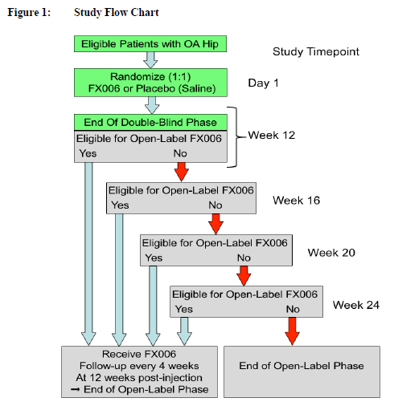
Study Flow Chart

Slide 29
Study Objectives – Double Blind Phase
Primary
  To assess the efficacy of FX006 on pain following an IA injection in patients with hip OA
Secondary:
  To assess the efficacy of FX006 on function, global impression of change, stiffness, quality of life, treatment satisfaction, sleep quality and consumption of rescue medication in patients with hip OA
  To assess the safety of FX006 in patients with hip OA

Slide 30
Study Objectives – Open Label Extension Phase
Primary:
  To assess the overall safety of a second injection of FX006 in patients with hip OA
Secondary:
  To examine efficacy following a second injection of FX006 in patients with hip OA

Slide 31
Blinding
Blinded-assessor technique will be used in this study in order to maintain double-blind conditions.
A site specific blinding plan will be developed to ensure the blind is maintained throughout the duration of the study.
Treatments will be prepared by an unblinded pharmacist/coordinator who has experience with the preparation of study medication and who has been properly trained by the Sponsor or designee.
IA injections will be performed by an unblinded injector.
The PI cannot serve as both Injector and PI, as the PI must be blinded.

Slide 32
Breaking the Blind
If there is a clinical adverse event that the Investigator judges requiring unblinding of study medication, they will promptly contact the Medical Monitor and review the situation. If the consensus is to unblind the subject’s treatment, a trained and authorized site user will log into the Emergency Study Code Break Module and will be provided the patient’s treatment assignment.
If there is a clinical adverse event that Pharmacovigilance or Regulatory judge requires unblinding of study medication, the Sponsor’s internal procedure will be followed.
If any site team member is unblinded for any reason, the Investigator will notify the Sponsor that unblinding has occurred, without revealing the treatment, and document who was unblinded, the reason for doing so, and the date of unblinding in a note to file.

Slide 33
Staffing Requirements – Unblinded Pharmacist/Coordinator
Must be a registered pharmacist or an individual with the qualifications and training required to handle and prepare study medications
Is responsible for handling and preparing all study medications and maintaining investigational product accountability records
Will not share treatment assignments with the blinded assessor, the patient and other blinded study personnel or Sponsor personnel/representatives and will make every effort to maintain the blind
Will have no other contact with the patient throughout patient’s participation in the study

Slide 34
Staffing Requirements – Unblinded Injector
Must be a Medical Doctor with experience in administering IA injections of the hip using fluoroscopy guidance
Is responsible for performing all IA injections of study medication using fluoroscopy guidance
Will not share treatment assignments with the blinded assessor, the patient and other blinded study personnel or Sponsor personnel/representatives and will make every effort to maintain the blind
Will have no other contact with the patient outside of treatment administration through patient’s participation in the study other than obtaining informed consent at the Screening visit, if applicable

Slide 35
Staffing Requirements – Blinded Assessor
Must be a medical doctor, a physician’s assistant, or nurse practitioner
Must have relevant OA experience
Is responsible for performing the physical examination and index hip assessments
Is responsible for assessing all adverse events for seriousness, severity, and relationship to study medication
Must not be present during the administration of study medication but should be available immediately thereafter to assess any safety events that may emerge

Slide 36
Unblinded Team Responsibilities
Overall unblinded team responsibilities are as follows:
Will have no other contact with the patient and will not have any other blinded roles on the study (the only exception is that the unblinded injector may be delegated the role of obtaining informed consent at the Screening visit)
Will not share treatment assignments with the blinded assessor, the patient and other blinded study personnel and Sponsor personnel/representatives
Will make every effort to maintain the blind (e.g., reconstitute the drug in an isolated room close to injection room to prevent others from seeing and hearing tapping process).

Slide 37
Unblinded Pharmacist/Coordinator
Depending upon site specific requirements, the unblinded pharmacist/coordinator may be split into two roles. Details will be specified in the site specific blinding plan.
Receives the randomization notification of the subject’s study treatment
Dispenses the appropriate prepared study treatment and necessary materials for the injection
Completes the drug accountability logs
Transports assigned treatment to the location where injection will take place
Will remain with the patient and unblinded injector until the injection is completed

Slide 38
Unblinded Pharmacist/Coordinator (Continued)
Ensures the blind is maintained by following the site specific blinding plan to ensure the patient is unaware of the treatment assignment prepared for injection
Performs the study drug reconstitution
Will ensure that the FX006 drug is re-suspended prior to injection
Will record details of study drug preparation, transport (if applicable) and administration
Will transport the used vials back to the drug storage location to be held until drug accountability is performed by the unblinded monitor.
The Unblinded Pharmacist/Coordinator will report any product-related issues relating to reconstitution or administration of FX006 according to Sponsor instructions located in Pharmacy Manual.

Slide 39
Unblinded Injector
Performs the study drug reconstitution (if not completed by the unblinded pharmacist/coordinator)
Will ensure that the FX006 drug is re-suspended prior to injection
Performs the aspiration and injection of the index hip using fluoroscopy in accordance with both their experience and the protocol-specified procedure.

Slide 40
Unblinded Sponsor Representatives
All other site and Sponsor personnel/representatives involved in the study at the site will be blinded with regard to the study medication being administered with the following Sponsor/representative exceptions:
Unblinded Monitor(s):
  Responsible for unblinded site monitoring.
  Will performing study drug accountability (used and unused vials)
Unblinded Clinical Manager:
  Responsible for oversight of unblinded site monitoring.
  Will review unblinded monitoring visit reports and escalate unblinded site issues to unblinded Sponsor representative

Slide 41
Unblinded Personnel
Unblinded Sponsor representative
  Point of escalation for unblinded team
  Will address any product related issues
  Will escalate in a blinded manner to the blinded study team, if necessary
Sponsor Regulatory and Pharmacovigilance personnel for safety assessment and reporting, if necessary

Slide 42
Inclusion Criteria for Double Blind Phase
Written informed consent has been obtained prior to initiating any study specific procedures
Willingness and ability to comply with the study procedures and visit schedules and ability to follow verbal and written instructions
Patients 40 to 80 years of age, inclusive, on the day of randomization (Day 1)
Body Mass Index (BMI) ≤ 40 kg/m²
Symptoms (including pain) associated with OA of the index hip for ≥ 3 months prior to Screening visit (patient self-report is acceptable); moderate to severe index hip pain due to OA for >15 days over the last month (as reported by the patient)

Slide 43
Inclusion Criteria for Double Blind Phase (Continued)
Currently meet the ACR Criteria (clinical and radiological) for OA of the index hip:
  Hip pain and radiographic femoral and/or acetabular osteophytes;
OR
  Hip pain and ESR ≤ 20 mm/hour and radiographic axial joint space narrowing KL Grade 2 or 3 in the index hip as confirmed by X-ray during Screening visit (centrally read)
KL Grade 2 or 3 in the index hip as confirmed by X-ray during Screening visit (centrally read)
Average WOMAC A (pain) score in index hip ≥ 5.0 and ≤ 9.0 (0-10 NRS scale) at Screening 2 visit and Day 1
Average WOMAC C (function) score in index hip ≥ 4.0 (0-10 NRS scale) at Screening 2 visit and Day 1

Slide 44
Inclusion Criteria for Double Blind Phase (Continued)
Ambulatory and no change in use or addition of assistive devices in the ≥ 3 months prior to screening
Agree to maintain the similar activity level throughout the study
Willingness to abstain from use of protocol-specified restricted medications and non-pharmacological therapies during the study

Slide 45
Exclusion Criteria for Double Blind Phase
Disease-related criteria
Patients who cannot washout of prohibited medications (Refer to Section 7.6.2) (e.g., opioids or other analgesics)
Diagnosed as secondary OA in the index hip including but not limited to articular fracture, major dysplasia or congenital abnormality, osteochondritis dissecans, acromegaly, ochronosis, hemochromatosis, Wilson's disease, or primary osteochondromatosis, etc.
Ipsilateral chronic knee pain
Contralateral hip and/or knee pain ≥ 4.0 (0-10 NRS scale) within 1 month prior to Screening visit
Sciatica
Atrophic osteoarthritis, femoral head necrosis and/or collapse, or subchondral bone insufficiency fracture in the index hip joint determined via central reading
Current or history of infection in the index hip (e.g. osteomyelitis) or current skin infection at injection site

Slide 46
Exclusion Criteria for Double Blind Phase (Continued)
Concurrent chronic pain conditions with pain score ≥ 4.0 (0-10 NRS scale) within 1 month prior to Screening visit, including but not limited to:
    hip impingement syndrome, trochanteric bursalgia
    peripheral or central neuropathy that may affect sensation of the index hip
    non-radicular low back pain
    peripheral nerve entrapment
    diabetic neuropathy
    post-herpetic neuralgia
    post-stroke pain
    fibromyalgia

Slide 47
Exclusion Criteria for Double Blind Phase (Continued)
Trauma or surgeries (e.g., arthroscopy, knee surgery) of lower limbs within 52 weeks with sequelae, etc.
painDETECT Questionnaire (PD-Q) score > 18 during Screening visit
Any planned surgeries in the lower limbs during the study period, or any other surgery during the study period that would require use of a restricted medication
History or current evidence of reactive arthritis, rheumatoid arthritis, psoriatic arthritis, ankylosing spondylitis, or arthritis associated with inflammatory bowel disease, systemic lupus erythematosus or other autoimmune diseases

Slide 48
Exclusion Criteria for Double Blind Phase (Continued)
Previous or concomitant treatment-related criteria
Presence of surgical hardware or other foreign body in the index hip
Planned/anticipated surgery of the index hip or any other surgery that would require use of a restricted medication during the study period
IA corticosteroid of any joint within 3 months of Screening visit (investigational or marketed, including FX006)
IA treatment of index hip with any of the following agents within 6 months of Screening: any biologic agent (e.g., platelet rich plasma (PRP) injection, stem cells, prolotherapy, amniotic fluid injection; investigational or marketed) or hyaluronic acid

Slide 49
Exclusion Criteria for Double Blind Phase (Continued)
Intravenous (IV) or Intramuscular (IM) corticosteroids (investigational or marketed) within 3 months of Screening
Oral corticosteroids (investigational or marketed) within 1 month of Screening
Inhaled, intranasal or topical corticosteroids (investigational or marketed) within 2 weeks of Screening visit
Planned or expected changes to lifestyle with regard to physical activity, physical therapy, acupuncture, transcutaneous electrical nerve stimulation (TENS), or bracing within 1 month prior to Screening and changes throughout the duration of the study

Slide 50
Exclusion Criteria for Double Blind Phase (Continued)
Patient-related criteria
Patients with a total score of ≥ 15 or >0 on Question #9 on the Patient Health Questionnaire-9 (PHQ-9) at Screening visit
Patients with a score of ≥ 15 on the Generalized Anxiety Disorder (GAD-7) at Screening visit
Patients with clinically relevant level of pain catastrophizing defined as Pain Catastrophizing Scale (PCS) score of ≥ 30 at Screening visit
Patients with Insomnia Severity Index (ISI) Questionnaire score ≥ 15 (moderate severity) at Screening visit
Known or suspected hypersensitivity to any form of triamcinolone or PLGA
Laboratory evidence of infection with HIV, positive test for HBsAg or positive serology for HCV with positive test for HCV RNA

Slide 51
Exclusion Criteria for Double Blind Phase (Continued)
A medical history suggesting the patient will or is likely to require a course of systemic corticosteroids during the study period
History or evidence of active or latent systemic fungal or mycobacterial infection (including tuberculosis), or of ocular herpes simplex
History of sarcoidosis or amyloidosis
History of or active Cushing’s syndrome
Selective serotonin reuptake inhibitors (SSRIs) (e.g., fluoxetine, fluvoxamine) if dose /regimen has not been stable for ≥6 months prior to Screening
Use of immunomodulators, immunosuppressives, or chemotherapeutic agents within 5 years of Screening
Active or history of malignancy within 5 years of Screening, with the exception of resected basal cell carcinoma, squamous cell carcinoma of the skin, or effectively managed cervical carcinoma

Slide 52
Exclusion Criteria for Double Blind Phase (Continued)
Active substance abuse (drugs or alcohol) or history of substance abuse within the past 12 months of Screening
Has received a live or live-attenuated vaccine within 3 months of Day 1
Use of any other investigational drug, biologic or device within 3 months of Screening visit
Any bacterial or viral infection requiring IV antibiotics within 4 weeks of Day 1 or oral antibiotics within 2 weeks of Day 1
Any other clinically significant acute or chronic medical conditions (e.g., uncontrolled diabetes) that, in the judgment of the Investigator, would preclude the use of an IA corticosteroid or that could compromise patient safety, limit the patient’s ability to complete the study, and/or compromise the objectives of the study

Slide 53
Exclusion Criteria for Double Blind Phase (Continued)
Patients contraindicated to the use of acetaminophen/paracetamol (allowed rescue pain medicine) per National Product Labeling and Investigator's judgment
Patient is the Investigator or any Sub-Investigator, research assistant, pharmacist, study coordinator, other staff or relative thereof directly involved in the conduct of the study
Women who are pregnant or nursing or plan to become pregnant during the study; men who plan to conceive during the study
Women of child-bearing potential (not surgically sterile or post-menopausal for at least 1 year as documented in medical history) not using a highly effective method of contraception [(abstinence; oral, injected or implanted hormonal methods of contraception; intrauterine device or intrauterine system; condom or occlusive cap (diaphragm or cervical/vault caps) with spermicidal foam/gel/film/cream/suppository, or male sterilization (vasectomy)]

Slide 54
Second Injection Inclusion Criteria
To be eligible to receive the second injection during the open-label phase, patients must fulfill the following criteria:
  Completed the double-blind phase of the study through Week 12
  No major safety concerns during the initial dose period (including allergic reaction to initial dose of study medication) as assessed by the Investigator and patient
  Clinically indicated to receive FX006, in the opinion of the Investigator and patient
  Average WOMAC A (pain) score of ≥ 3 (0-10 NRS)
  Compliant with study procedures and visit schedules up to the open-label injection with FX006 and the willingness and ability to continue to comply for additional 12 weeks after the second injection
  Willingness to continue abstaining from use of protocol-restricted medications during the study

Slide 55
Second Injection Exclusion Criteria
Patients fulfilling at least one of the following criteria may not be included in OLE phase of the study:
  Clinical signs and symptoms of active hip infection or crystal disease of the index hip
  Received a non-protocol specified IA intervention (IA injection, IA aspiration, etc.) in index hip during study participation
  Use of immunomodulators, immunosuppressives, or chemotherapeutic agents during study participation.
  Received a live or attenuated vaccine during study participation
  Use of any other investigational drug, device or biologic during study participation
  Any bacterial or viral infection requiring IV antibiotics within 4 weeks or oral antibiotics within 2 weeks of second injection
  Skin breakdown at the hip where the injection would take place
  Women who are pregnant or nursing or plan to become pregnant during the study; men who plan to conceive during the study

Slide 56
Second Injection Exclusion Criteria (Continued)
Women of child-bearing potential (not surgically sterile or post-menopausal for at least 1 year as documented in medical history) not using a highly effective method of contraception [abstinence; oral, injected or implanted hormonal methods of contraception; intrauterine device or intrauterine system; condom or occlusive cap (diaphragm or cervical/vault caps) with spermicidal foam/gel/film/cream/suppository, or male sterilization (vasectomy)]
Any other clinically significant acute or chronic medical conditions (e.g., bleeding disorder) that, in the judgment of the Investigator, would preclude the use of an IA corticosteroid or that could compromise patient safety

Slide 57
Withdrawals/Screen Failures
Minimal data for patients who fail screening such as demographic information and the reason for screen failure will be collected.
Patients that fail to meet eligibility criteria may be re-screened at the discretion of the Medical Monitor.
The Medical Monitor will clearly document the rationale for any re‑screening decision.
Patients that are allowed to re-screen will be assigned a new screening number, re‑consented and may have screening assessments repeated if necessary.

Slide 58
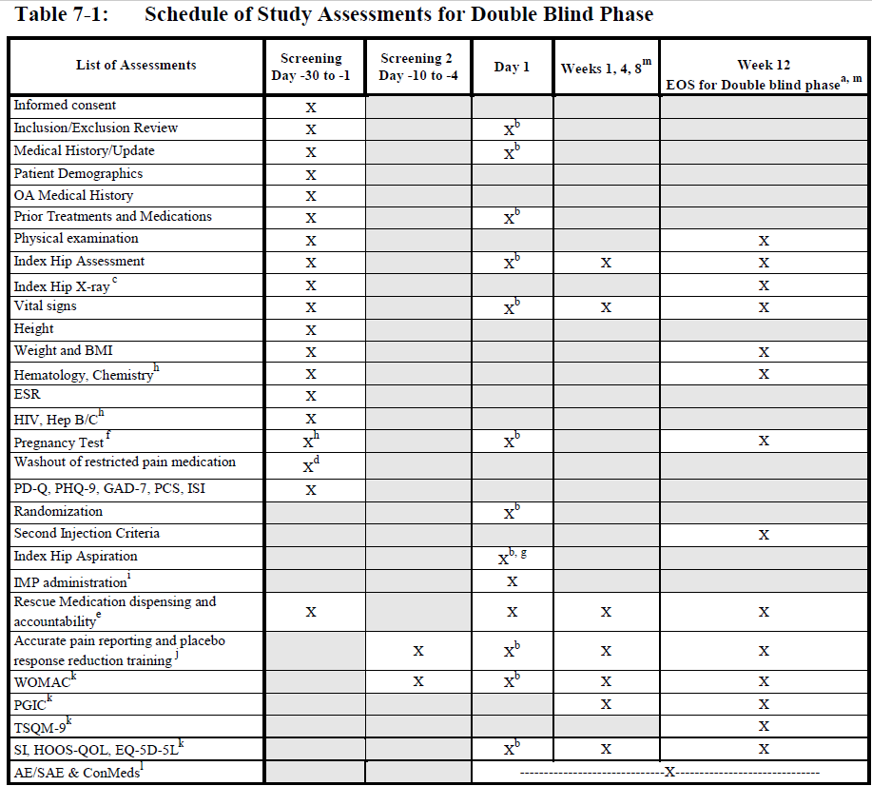
Study Assessments – Double Blind Phase

Slide 59
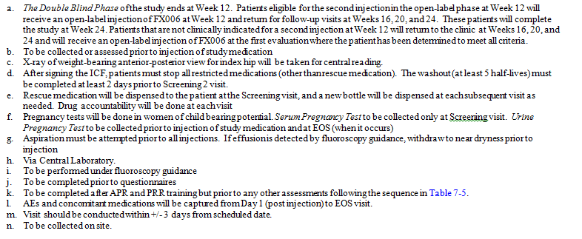
Study Assessments Footnotes – Double Blind Phase

Slide 60
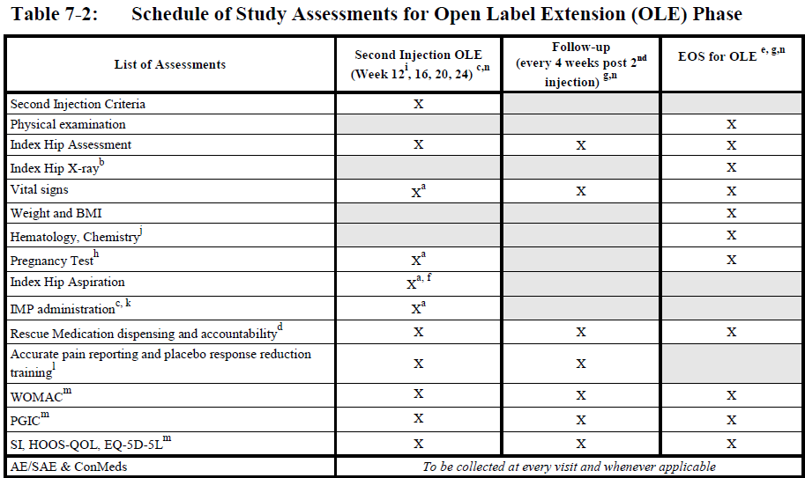
Study Assessments – Open Label Extension Phase

Slide 61
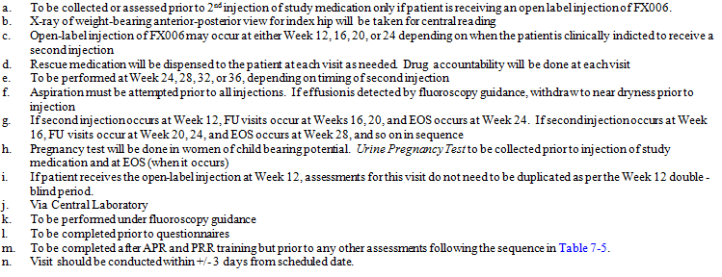
Study Assessments Footnotes – Open Label Extension Phase
Open Label Extension Phase Schedule of Assessments

Slide 62
Procedures and Assessments – Patient Questionnaires
Sequence at Visit | Screening | Screen 2 | Day 1 | Weeks 1, 4, 8 | Week 12 | Every 4 weeks during the OLE
1 | PD-Q | WOMAC | WOMAC | WOMAC | WOMAC | WOMAC
2 | PHQ-9 |  |  | PGIC | PGIC | PGIC
3 | GAD-7 |  | SI | SI | SI | SI
4 | PCS |  | HOOS-QOL | HOOS-QOL | HOOS-QOL | HOOS-QOL
5 | ISI |  | EQ-5D-5L | EQ-5D-5L | EQ-5D-5L | EQ-5D-5L
6 |  |  |  |  | TSQM

Slide 63
Questionnaires
We will now review the following questionnaires individually
PD-Q – PainDETECT Questionnaire
PHQ-9 – Patient Health Questionnaire-9
GAD-7 – Generalized Anxiety Disorder
PCS – Pain Catastrophizing Scale
ISI – Insomnia Severity Index
WOMAC – Western Ontario and McMaster Universities Osteoarthritis Index
PGIC – Patients’ Global Impression of Change
SI – Sleep Interference
HOOS-QOL – Hip Injury and Osteoarthritis Outcome Score
EQ-5D-5L – EuroQol 5 Dimensions 5 Levels Questionnaire
TSQM – Treatment Satisfaction Questionnaire for Medication

Slide 64
Study Procedures
Physical Exam
The physical exam will assess the following body systems:
  General Appearance
  Skin
  Lymphatics
  HEENT (head, ears, eyes, nose, throat)
  Cardiovascular
  Respiratory
  Abdominal
  Musculoskeletal
  Neurological
Any clinically significant findings outside of the typical disease state must be documented in the source and added to the medical history if found at Screening or recorded as an AE if new or worsened from pre-dosing on Day 1.

Slide 65
Study Procedures
Index Hip Assessment
Performed by the blinded assessor at the days indicated in the Schedule of Study Assessments
The index hip will be assessed for tenderness, heat/redness, swelling, and effusion.
If there is a clinically significant finding at the Screening or Day 1 Visit (pre-injection), add to the Medical History.
At time points post-injection, if there are new clinically significant findings or findings that worsen for the patient’s baseline condition, record as AEs.

Slide 66
Study Procedures
Index Hip X-Ray
A diagnostic quality X-ray of the index hip is required (weight-bearing anterior-posterior pelvic view with the lower limbs in 10 degree internal rotation with a size ratio of 1:1) at Screening, Week 12, and End of Study Visit (for patients who receive an open-label injection of FX006
Screening X-ray will be read centrally for K-L grading and potential risk signs of rapidly progressive OA (e.g., atrophic osteoarthritis, femoral head necrosis and/or collapse, subchondral bone insufficiency fracture, etc.).
In addition to the Screening X-ray, the Week 12 and End of Study X-rays will be read centrally for safety assessments (e.g., joint space narrowing, sclerosis/attrition, osteonecrosis, insufficiency fracture).
An image acquisition protocol will be distributed to sites with instructions for radio-anatomic positioning for reliable grading.
Notes:
Discuss with the site who will be uploading images to AGMedNet (SC or image tech). Go over the time needed for QC and KL grade acceptability for eligibility

Slide 67
Study Procedures
Vital Signs
Vital signs are to be taken at the days indicated in the Schedule of Study Assessments.
The following measurements will be taken:
  Sitting blood pressure
  Heart rate
  Respiration rate
  Temperature
Height (cm or in) and weight (kg or lb) are to be taken at the days indicated in the Schedule of Study Assessments.
BMI will be calculated by the site at Screening using the formula referenced in Section 7.9.8 of the protocol.

Slide 68
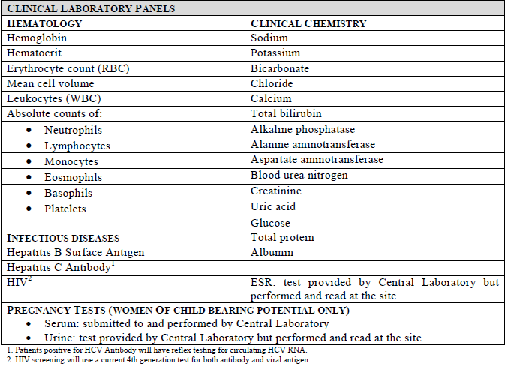
Study Procedures – Central Lab PPD

Slide 69
Study Procedures – Central Lab PPD
PPD will provide sites with:
  Laboratory Manual
  Labels
  Lab Kits
  Airway Bills
FedEx will be used for shipment of hematology, chemistry and serology samples
Central Lab data will not be uploaded into EDC
  PI, or delegated staff member, will review lab results for applicable visits and sign off on report. Any abnormal findings should be designated as either clinically significant or non-clinically significant

Slide 70
Study Procedures
Index Hip Aspiration
Aspiration must be attempted prior to injection of study medication at Day 1 and prior to second injection of study medication.
If effusion is detected by fluoroscopy guidance, withdraw to near dryness prior to injection.

Slide 71
Allowable Medications / Non-Pharmacologic Therapies
Any treatment for a pre-existing condition or for an AE, outside of the study indication, that is not listed as restricted (with the exception of antibiotics)
Study-allocated rescue medication
Aspirin for cardio protection at a maximum stable dose of 325 mg per day provided the dose has been stable over the 3 months prior to Screening
Selective serotonin reuptake inhibitors (SSRIs) (e.g., fluoxetine, fluvoxamine) provided the dose has been stable over the 6 months prior to Screening
Stable lifestyle with regard to physical activity, physical therapy, acupuncture, TENS, or bracing within 1 month prior to Screening and throughout the duration of the study

Slide 72
Restricted Medications / Non-Pharmacologic Therapies
Oral non-steroidal anti-inflammatory drugs (NSAIDs)
Aspirin (>325 mg per day)
Centrally-acting pain medications (e.g., pregabalin, gabapentin, duloxetine, milnacipran)
Opioids
Topical therapies (e.g., NSAIDs, capsaicin, lidocaine patches, other local treatments) applied to the index hip
Anesthetic medications injected locally in the index hip (other than lidocaine if used for IA injection procedure)
Muscle relaxants (e.g., cyclobenzaprine, tetrazepam, diazepam)
IV, IM, oral, inhaled, intranasal or topical corticosteroids
IA corticosteroids in any joint
Any IA intervention in the index hip (e.g., IA viscosupplementation (hyaluronic acid))

Slide 73
Restricted Medications / Non-Pharmacologic Therapies Contd.
SSRIs (e.g., fluoxetine, fluvoxamine) if the dose is not stable for at least 6 months prior to Screening visit
Any investigational drug, device or biologic
Immunomodulators, immunosuppressives, or chemotherapeutic agents
Live or live-attenuated vaccines
Changes to lifestyle with regard to physical activity, physical therapy, acupuncture, TENS, or bracing within 1 month prior to Screening and changes throughout the duration of the study

Slide 74
Rescue Medications
To standardize pain-relief rescue medication across all patients, starting at screening, patients will discontinue all prohibited medications and follow procedures:
The designated rescue medication is acetaminophen (paracetamol) 500 mg, one tablet every 4 to 6 hr, to a maximum of 6 (six) tablets (3000 mg) per 24 hr period.
Patients may not take any rescue medication during the 48 hr prior to a study visit.
Starting at screening and at each study visit, patients will be provided with a sufficient quantity of rescue medication for the interval to the next scheduled visit.
At each visit, patients will return the bottles provided at the previous visit for rescue medication accountability and be issued a new supply.
  Unused rescue medication bottles should not be re-dispensed

Slide 75
Investigator/Site Qualifications and Responsibilities
FX006-2018-015 SIV Training

Slide 76
Study Staff and Delegation of Tasks
Medically qualified Principal Investigator (blinded evaluating), Sub-Investigator (unblinded injector) and qualified site staff are required for conduct of study
Delegation of study tasks may be done by PI, however… responsibility for conduct of the clinical trial may not be delegated by the PI
Principal Investigator exercises oversight of study
  Medical Care of Trial Subjects
  Prompt Communications with IRB
  Compliance with Protocol
  Obtaining Informed Consent of Trial Subjects
  Supervises qualified study personnel
  Careful Management of Investigational Product
  Adherence to Randomization Requirements
  Maintaining Adequate & Accessible Records and Reports
  Providing Periodic Progress Reports to IRB, as needed
  Safety Reporting per Protocol
  Submitting Final Report to IRB, as needed

Slide 77
Investigator / Site Responsibilities
  Ensure that eCRFs are completed within 5 days of the subject visit.
    Some Screening eCRF Data must be entered before enrollment of the subject can take place
  Ensure that all applicable logs are current, i.e. Delegation of Study Related Duties, Confidential List of Subjects
  Ensure the quality of regulatory documents
Ensure proper storage of the investigational product
Ensure all AEs are documented and reported in the required timelines
Ensure the Investigator Site File contains all essential documents
Report deviations to the IRB in accordance with Quorum IRB reporting guidelines

Slide 78
Study Tools

Slide 79
Vendors involved with Study
Vendor | Role | For more info refer to
PPD | Central Lab | PPD Lab Manual
Axiom | EDC, CTMS (Deviations), General Log (questions for Medical Monitor) SAE reporting, drug tracking, payment | Axiom Website
Advarra | Central IRB | Advarra IRB website
TCG | Drug Supply Ancillary supplies Rescue medication | Pharmacy Manual (unblinded only)
Spire | Imaging | Imaging Manual
Analgesic Solutions | APR/PRR Training | Training Modules

Slide 80
Tools provided to Sites
Tool | Target audience | Provided from
Investigator Study File (ISF) | PI/SUB-I/SC Includes regulatory documentation and Restricted Medication List | Flexion/CRMG
Pharmacy Binder | Unblinded Staff | Flexion/CRMG
Mini protocols | All staff | Flexion/CRMG
PPD Lab Manual | PI, Blinded Sub-Investigator, Blinded SC | PPD
Source Document Binders | PI, Blinded Sub-Investigator, Blinded SC Includes Multiple Patient Binders | CRMG
eCRF Completion Guidelines | PI, Blinded Sub-Investigator, Blinded SC | Axiom
Imaging Manuals | Injector, Unblinded Pharmacist/SC | Spire
iPad (APR/PRR Training) | Blinded Study Coordinator | Flexion

Slide 81
Regulatory Binder/ISF – Blinded
The Regulatory Binder/ISF serves as the permanent file for all study-specific documents at site.
  Any/all study documentation to be filed in ISF, with the exception of the site budget and site contract
  Documents to be filed in chronological order, newest on top within each tab
  If divided into several binders (due to size), must clearly label each binder with protocol #, protocol name, and brief description of contents
  IRB-approved Materials
  It is the site’s responsibility to file the IRB approved versions of the following patient materials in the ISF for use.
  ICF
  Protocol
  Additional Approvals

Slide 82
Pharmacy Binder - Unblinded
The Pharmacy Binder will be maintained by unblinded pharmacist/study coordinator
Blinded staff will not have access.
Product Complaint Form
  Email to ProductComplaints@flexiontherapeutics.com
Temperature Excursion Form
  Email to clinicalsupplies@flexiontherapeutics.com

Slide 83
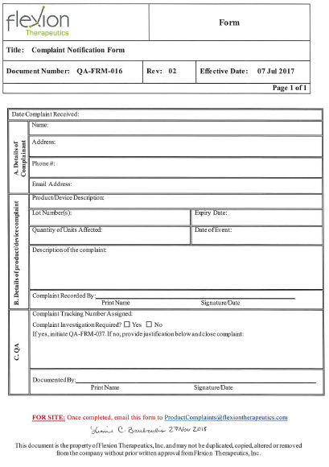
Complaint Notification Form

Slide 84
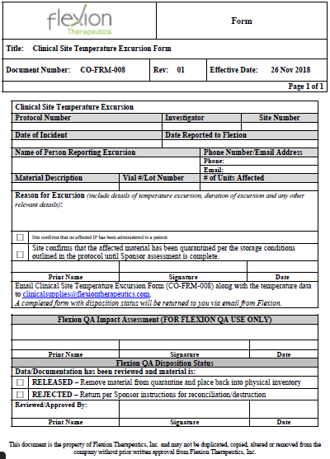
Temperature Excursion Form

Slide 85
Supplies Sent to Site
Supplies | Provided From | When
Lab Kits and Bulk Supplies | PPD | Prior to SIV
Ancillary Supplies: Needles/Syringes Rescue medication IP: FX006 Packaged Kits Normal Saline Vials | TCG | Prior to SIV After activation

Slide 86
Source Documents

Slide 87
Source Documents
If it is not documented in writing, it did not happen
Source includes medical records/chart entries, x-ray reports, lab reports, clinic progress notes, study chart progress notes & logs, and the “proverbial cocktail-napkin notation”
Suggested source documents are available.
  Supplied to sites for use, though not required. If site uses own source documents, these must be reviewed and approved by CRMG first, then by Sponsor
  If used, may be supplemented with additional documentation
  Source could also be a patient’s progress note, hospital records, etc
All source must be available for review by the CRA at each monitoring visit for 100% Source Document Verification (SDV)
100% SDV will be performed for this study

Slide 88
Record Retention for Sites
In accordance with US federal regulations (21 CFR 312.62[c]), the Sponsor requires that records and documents pertaining to the conduct of this study and the distribution of study medications, including eCRFs, consent forms, laboratory test results, and medical inventory records, must be retained by the Principal Investigator for 2 years after marketing application approval.
If no application is filed, these records must be kept 2 years after the investigation is discontinued and the regulatory authorities are notified. The Sponsor or their representative will notify the Principal Investigator of these events.
In the event that local regulations are more stringent than that specified above, the local regulations will be adhered to. If local records retention regulations are more stringent than that specified above, the local regulations will prevail.

Slide 89
Regulatory Authority Inspections
If contacted by the FDA or other Regulatory Agency, sites are to contact Flexion or assigned CRA immediately to obtain help in preparations
Types of inspections
  Surveillance Audit
  For Cause Audit
Inspection consists of:
  Review conduct of study
  Review regulatory documents
  Audit data

Slide 90
Informed Consent
Person explaining the IRB approved informed consent must sign and personally date their signature.
The subject must sign and personally date their signature.
All signatures on the Informed Consent Form must be present BEFORE any study procedures are performed
The informed consent process should be documented including the date, time and summary of the consent process.
  Note whether or not the patient was given a copy of the signed ICF.

Slide 91
Monitoring Visits Frequency
*Monitoring Visits to be 1-2 days
Visits | Frequency
Blinded IMV | 1st IMV: Within 2 weeks of 1st patient enrolled at site Site can not enroll more than 3 patients before 1st IMV Subsequent IMV: Generally, every 6-8 weeks depending on enrollment, workload, etc. | Blinded CRA Focus: Everything except Pharmacy/ IP Accountability
Unblinded IMV | 1st IMV: Within 2 weeks of 1st patient enrolled at site Site can not enroll more than 3 patients before 1st IMV 2nd IMV: After the last patient has received the 2nd injection in the OLE phase *Additional IMVs may be required depending upon site enrollment activity | Unblinded CRA Focus: Pharmacy/ IP Accountability
Closeout | On-site COV after the trial has been completed at each site and after database lock. | Blinded CRA Focus: Everything

Slide 92
Spire X-Ray Imaging Overview
FX006-2018-015 SIV Training

Slide 93
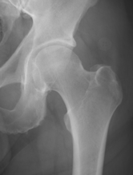

Spire Sciences’ Role in FX006-2018-015
Image collection and quality control
  Imaging protocol design
  Site training / support
  Image receipt, quality control, feedback
Image analysis
  Dedicated, specialized, expert radiologists
  Highly experienced in OA trials
    2 other trials of FX006

Slide 94
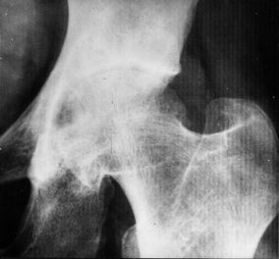
Roles of Imaging in FX006-2018-015
Subject selection
  Diagnosis
  Prognosis
Monitoring safety of FX006
  Osteonecrosis
  Subchondral insufficiency fracture (SIF)
  Accelerated OA
    Breakdown of subchondral bone
    Chondrolysis
: definitive structural OA (osteophytes, cartilage loss)
: severity of damage (Kellgren-Lawrence Grade)
Risk factors for disorders that can be confused as complication to FX006
  Preexisting osteonecrosis
  Preexisting subchondral fracture
    Subchondral insufficiency
    Osteochondritis dissecans
  Atrophic OA
joint-space narrowing (JSN)
osteophytes

Slide 95
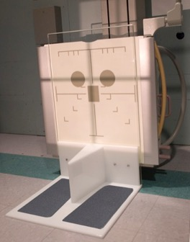
Hip Radiography (Target Hip Only)
Standing frontal (AP) view
Standing oblique (false profile of Lequesne) view
Fixed-Flexion Frame

Slide 96
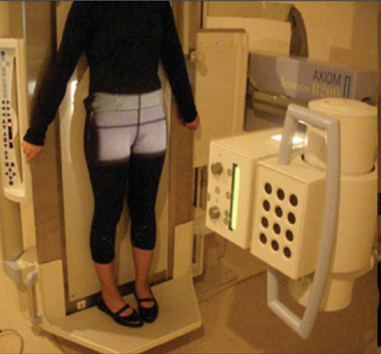
Standing Frontal (AP) View
Target
femoral head
X
Feet internally rotated
Feet internally rotated

Slide 97
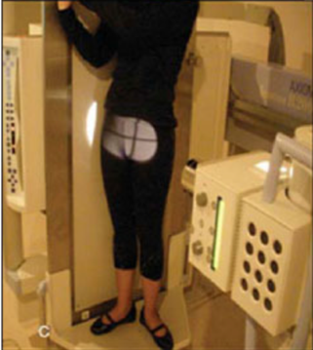
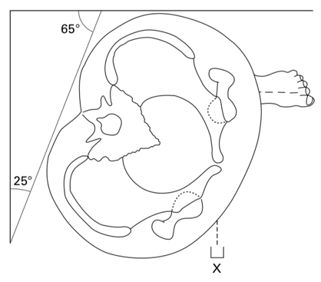
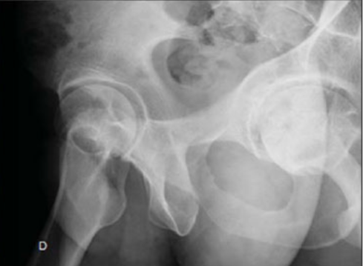
Oblique View (False Profile of Lequesne)
Left hip
Left hip
Left foot
65º
X-ray beam

Slide 98
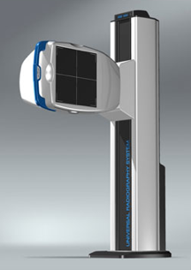
General Parameters
Imaging System | Bucky
Focus-Film Distance (FFD) | 72 in. or 50 in.
Film Size | 14 in. X 17 in.
mA | Depends on system
KVp | 65 – 72 kVp
Focal Spot | Small
Annotation | Right/Left markers
Tube angulation | 0° perpendicular
Use Same System/Parameters for All Visits!

Slide 99
Key Image Quality Criteria
Full anatomical coverage of target hip
Sharp cortical and trabecular lines
Good exposure, no artifacts
Reproducible projection of joint space on FU

Slide 100
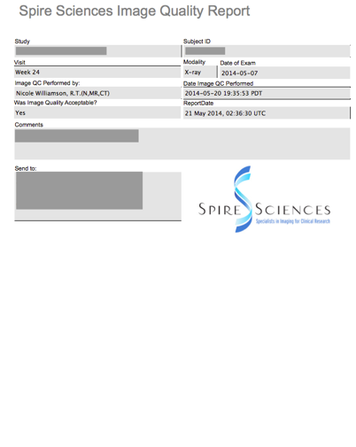
Image Quality Reports
To:
Investigator
Study Coordinator
XR Technologist
CRA
Flexion

Slide 101
Repeat Requests
Only when necessary
Spire Sciences will phone or email site
Rescan patient as soon as possible (<7 days)

Slide 102
Image Submission
Images submitted to Spire via AG Mednet
  Easy to use (any networked laptop)
  Built-in image anonymization
  Fully 21 CFR Part 11 compliant
Submit images immediately
  Site radiologist does not need to read the images
      Clinical research not patient management
  Spire reports image quality and subject eligibility
  Screen failures verified by second radiologist

Slide 103
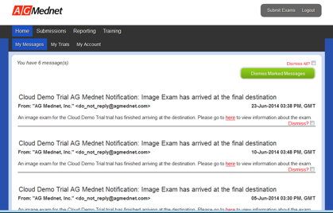
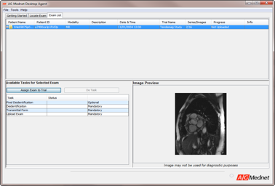
AG Mednet Upload Network
AGM Portal
  Register for AGM account
    User name and password
    https://portal.agmednet.net
  Management / notification tools
AGM Desktop Agent
  De-identify DICOM data
  Complete Transmittal Form
  Upload exam
  Confirm successful submission

Slide 104
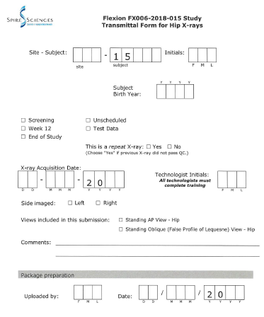
Electronic Image Transmittal Form

Slide 105
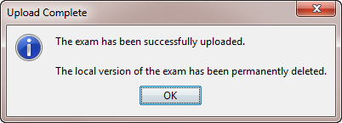
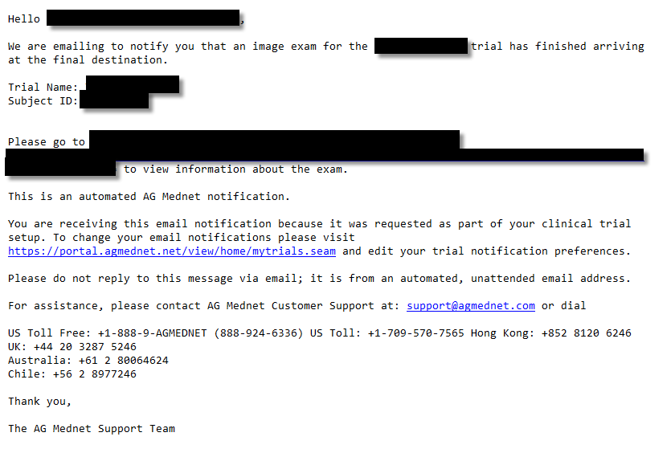
Confirmation of Successful Upload
Desktop Agent pop-up window
Confirmatory email
  Site tech, Spire QC
  Link to view details on Portal

Slide 106
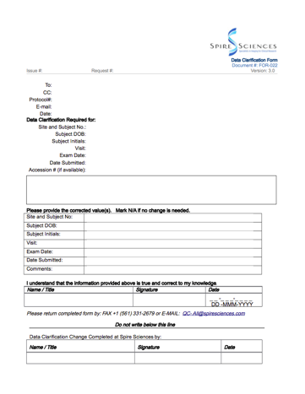
Data Clarification Form
  Ensure correct subject ID and visit name before uploading
  GCP requires documentation of any changes
    Data Clarification Form

Slide 107
5-Step Site Qualification
Site contact info
  Email and phone for PI, SC, X-ray technologists
  Mailing address for X-ray technologist
  Delivery of study materials
  Fixed Flexion Frames
  Radiographic procedure manual
  AG Mednet image upload manual
  links to training video and quiz

Slide 108
5-Step Site Qualification
Web-ex training:
  Overview of imaging protocol
  Use of Fixed Flexion Frame
  Subject positioning
  Beam centering
  Image upload
Each XR tech must complete an on-line quiz
Qualification notice sent
  PI, SC, XR techs and Flexion
Site starts imaging study subjects

Slide 109
PPD Central Lab
FX006-2018-015 SIV Training

Slide 110
PPD Supplies and Logistics

Slide 111
PPD Central Lab Supplies
Laboratory manual
Collection flow chart
Specimen collection kits contain
  Pre-labelled requisition form
  Pre-labelled collection and transport tubes
  Ancillary supplies
Shipping materials
  Shippers
  Pre-printed courier air waybills
  Courier contact sheet
  Other material as required
Study-specific materials
  Resupply request form
  Demographic change request form
  *Note: Each Kit is a stand-alone kit to be used for a single patient visit*

Slide 112
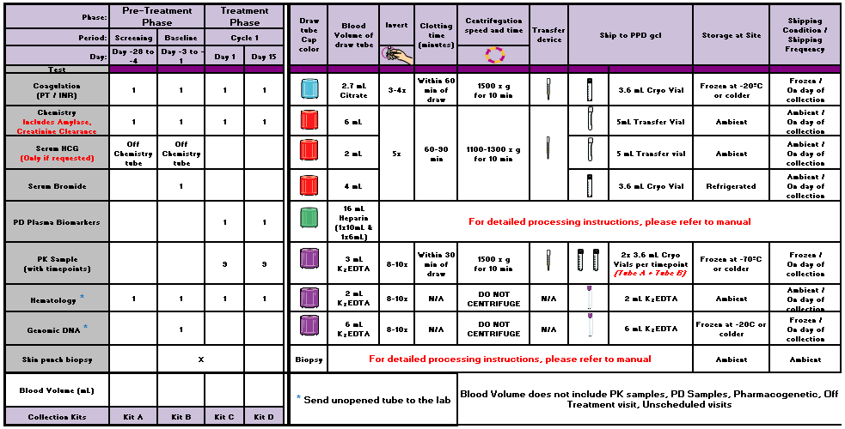
Collection Flow Chart
Processing Instructions
Shipping condition
Order of draw
Kit type to use
Notes:
This is a smaller version with columns removed for ease of reading. The full version will be supplied with initial supplies.

Slide 113
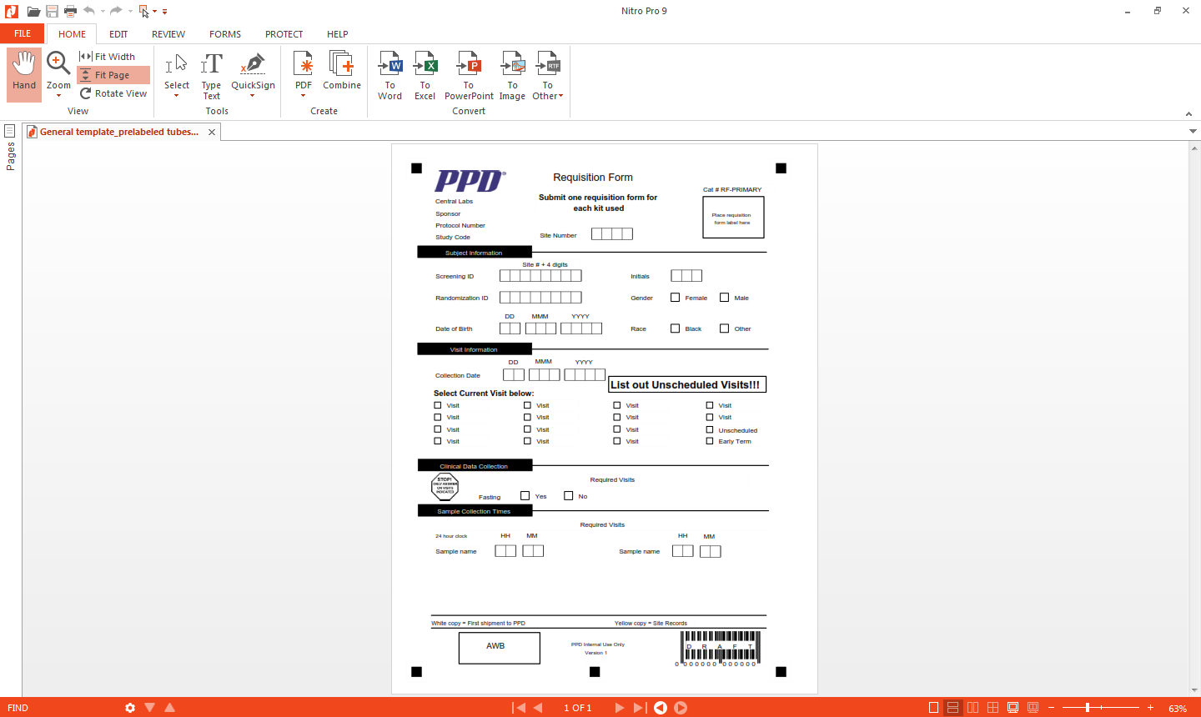
113
PPD Laboratories: Example Requisition Form
PPD Laboratories Address Sponsor; Protocol ID; Site #
Subject / Patient
Demographics
Visit Collection Date
Study Visit Selection
Clinical Data Collection
e.g. Race, Weight, etc.
PPD Laboratories Internal Use Only

Slide 114
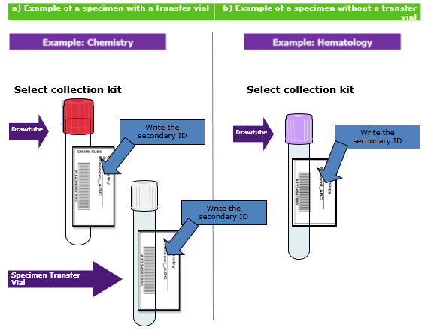
Pre-labelled Specimen Collection Kits
Each kit covers one visit for one subject only
Each Kit contains
  Pre-labeled requisition form(s)
  Pre-labeled collection and
  transfer vials
  Ancillary supplies (pipettes, needles etc.)
  Packing list
Kits are labeled with
  Protocol
  Sponsor
  Kit type
  Visit(s) ID
  Expiration date
  Lot number
NOTE: The barcodes on the packing list are identical to those on the samples, which allows for online accessioning in Central Lab Portal without the samples in hand.

Slide 115
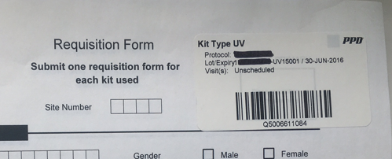
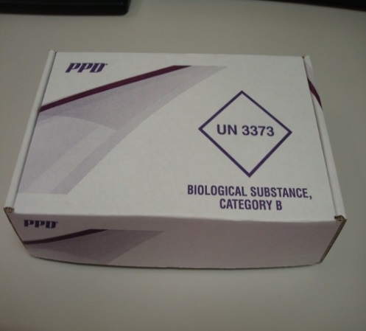
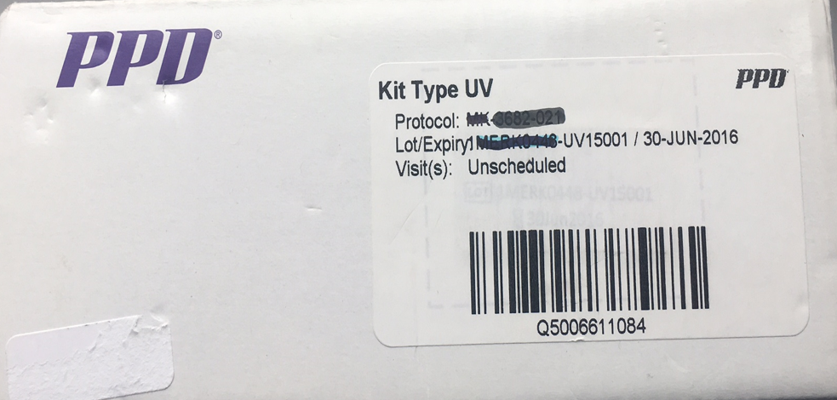
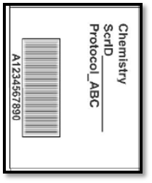
PPD Laboratories: Pre-labelled Kits
115
Barcode on the Kit
Same Barcode on the Requisition which ties form to it’s kit
Barcodes on tubes are linked to the requisition and the kit.
Barcode on collection Tube
Barcode on Transport Tube

Slide 116
Supply Management
Ordering options
  Fax a resupply request form to global site
  services (GSS)
  Call GSS
  Submit order through Preclarus Portal
Inventory management
  Average expiry of 8 months. Each kit is labeled with the expiry date. Site must not use expired kits.
  Sites are responsible for monitoring kit inventory to ensure supplies are available for patient visits
  5 full business days needed to prepare supplies and process orders for shipment, an additional 5 business days is required to ensure kits are shipped and onsite within 10 business days from placing the order.

Slide 117
Initial and Resupply Orders
Initial Orders→ are requested by the Clinical team and contain:
Laboratory Manual
Collection Flow Chart (CFC)
Resupply Order Form
Demographic Change Form
PPD Laboratories collection kits
Courier information and pre-printed air waybills (for standard couriers)
Shipping boxes and materials (if applicable)
General bulk ancillary supplies (if applicable)
Study specific materials
Re-supply Orders→ ordered by the sites via:
PPD Preclarus® Investigator Site Portal
Resupply Order Form
Kit Expiration Notices will be emailed to the site: 1 month, 1 week and 1 day prior to a kit expiring, kits will NOT re-supply automatically

Slide 118
PPD Portals
PPD Preclarus® Investigator Site Portal
PPD Preclarus® Lab Data Portal

Slide 119
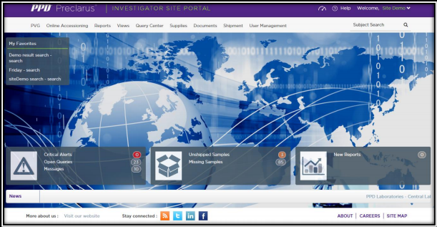
PPD Preclarus® Investigator Site Portal
Study Sites
Web-based – LINK: http:// preclaruslabdata.ppdi.com
Sample Accessioning: Three Easy Steps
Patient registration (one-time per patient)
Accession Samples
Create Shipment
Additional Tools
Sample Inventory Management at Site
Generates on-line requisition forms
View and respond to PPD Queries
View PPD Reports
Order Supplies
Access to view / print study documents
On-Line Sample Accessioning Strengthens Sample Chain of Custody

Slide 120
PPD Preclarus® Investigator Site Portal
Study Sites
Account Activation / Management
      The account activation email is sent to the Principal Investigator (PI) and Study Coordinator (SC) email address
      Account activation link embedded in activation email
      Expires after seven calendar days
      PI or SC clicks on link to activate site and create a password
      PI and SC will have account management capabilities and can manage access for other site personnel
Note: For detailed instructions on Preclarus ® account activation and trouble shooting, please refer to the Preclarus ® User Guide under the Help tab within the Preclarus ® portal

Slide 121
Analgesic Solutions
FX006-2018-015 SIV Training

Slide 122
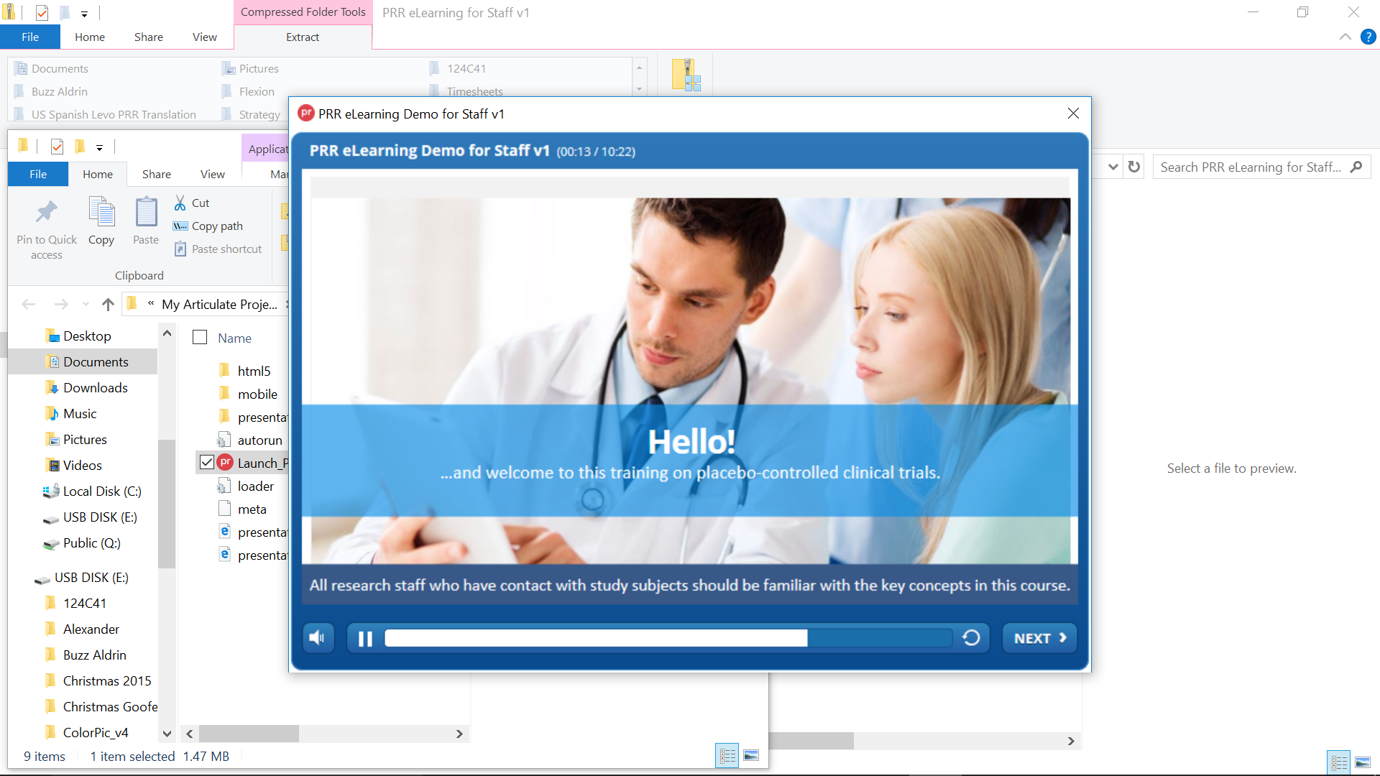
Practical details of training for this study
    Research Staff:
      Complete Accurate Pain Reporting & Placebo Response Reduction for Staff training
        Participate in Investigator Meeting training
        Log on to aLearn to take on-line training
        Pass certification assessment for each training – 80% or greater
    Study Subjects:
      Complete Accurate Pain Reporting & Placebo Response Reduction for Subjects training
        Log on to aLearn to take on-line training
        Subjects are required to take an assessment, but it is intended to demonstrate understanding and is not graded for certification
        Have subjects review training prior to answering questionnaires

Slide 123
Staff Accounts
  aLearn is set up using individual staff member accounts
  Login credentials will be username and password
      Only Analgesic Solutions can set up staff accounts
Flexion provides list of staff members users to Analgesic Solutions
    Staff member list fields:
      Full Name
      Email Address
      Title
      Site ID
      City
      State
      Country

Slide 124
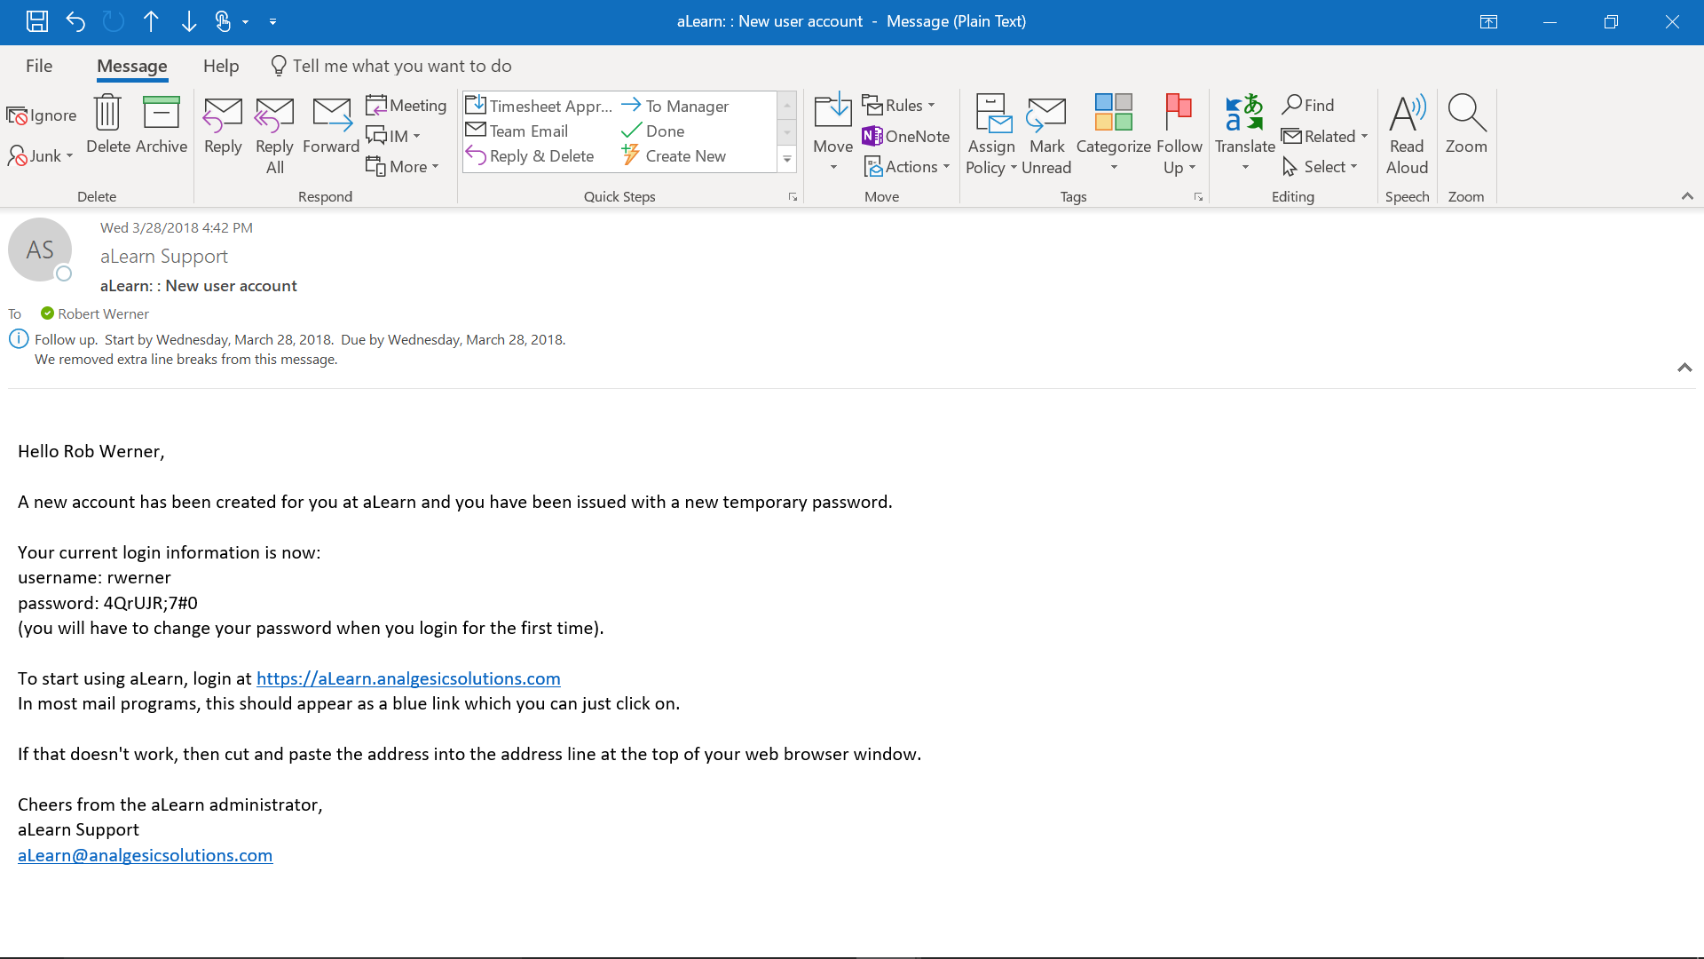
Staff Accounts
Analgesic Solutions uploads list
An automated email from aLearn is sent to each new user with pre-set login credentials
  Staff members will be prompted to change their passwords
  Important for staff to check junk email folder if email does not come through
Username 1
Username 1
https://aLearn.io
https://aLearn.io

Slide 125
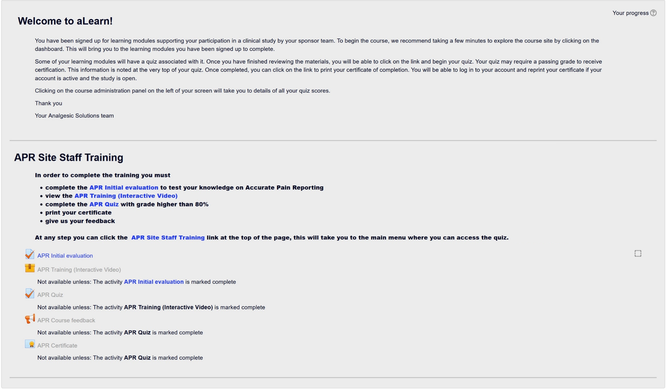
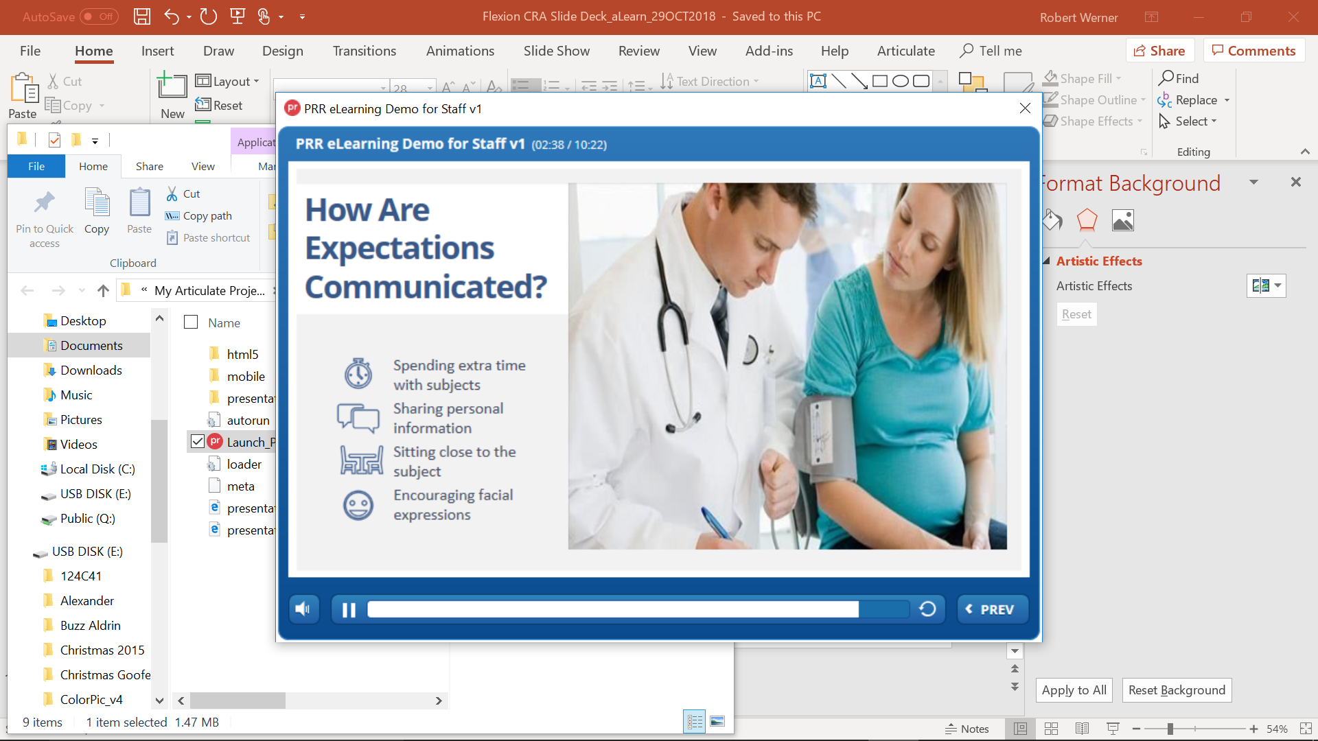
Staff Training Activities
Staff training modules are set up to be completed in the following order:
Training: The training consists of two eLearnings addressing Accurate Pain Reporting and Placebo Response Reduction, each presented as a separate course. (APR interface is pictured below at left, sample PRR screen at right)

Slide 126
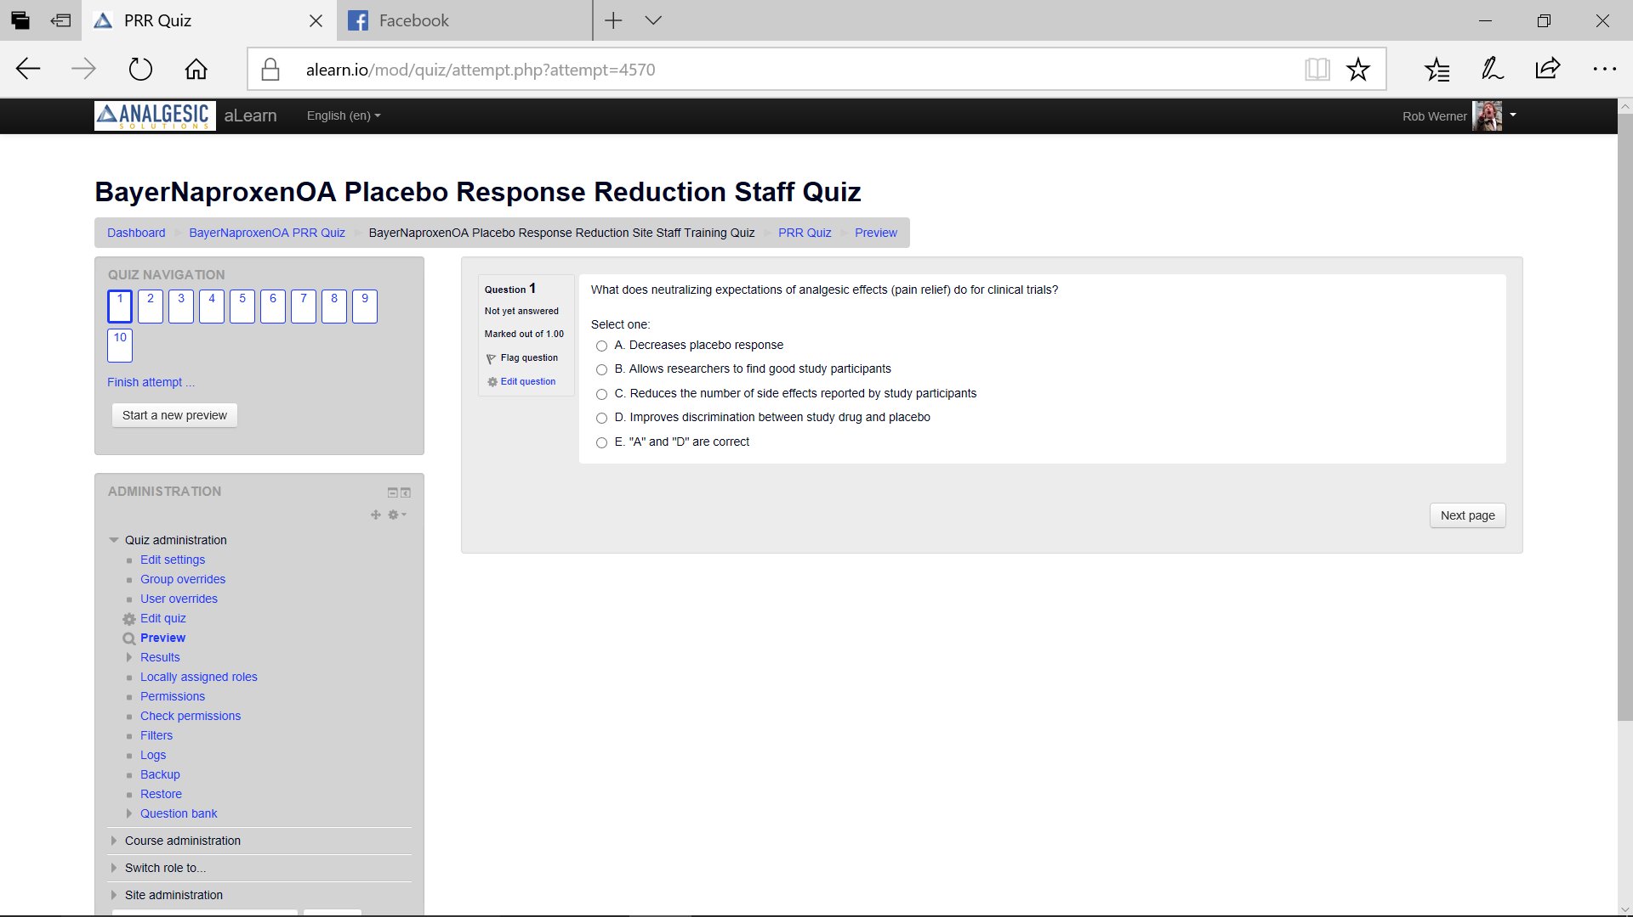
Staff Training Activities
Certification assessment: The assessment will consist of ten multiple choice questions based on the eLearning. Please note: staff is given unlimited attempts to pass certification assessment.

Slide 127
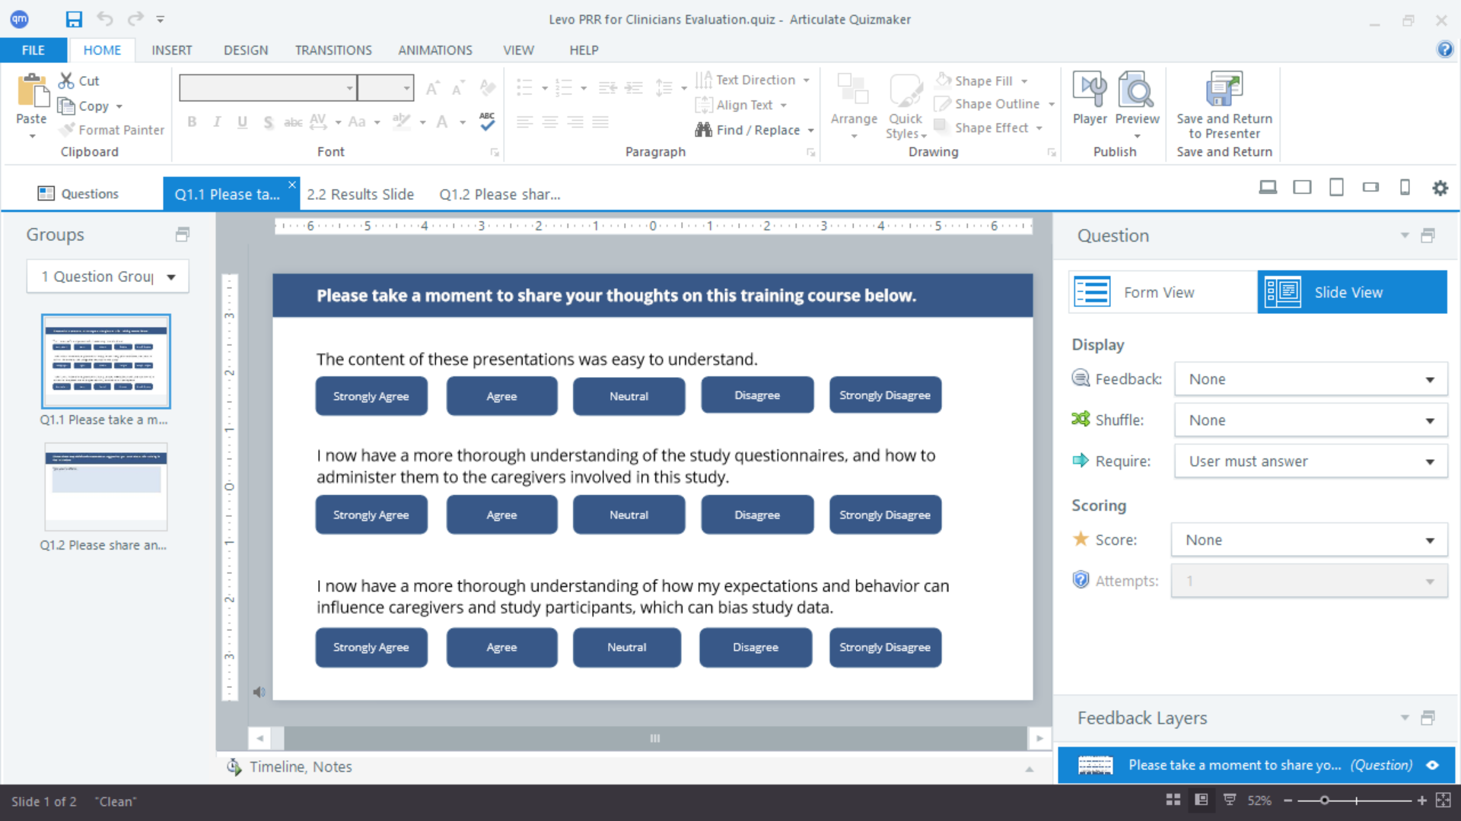
Staff Training Activities
Feedback: Users are encouraged to provide feedback after completing the training. A link to our feedback survey will be accessible once the eLearning is complete.

Slide 128

Staff Training Activities
Certification: After completing the eLearning and certification assessment quiz, the training module certificate will be accessible.
Staff Training
User Name 1

Slide 129
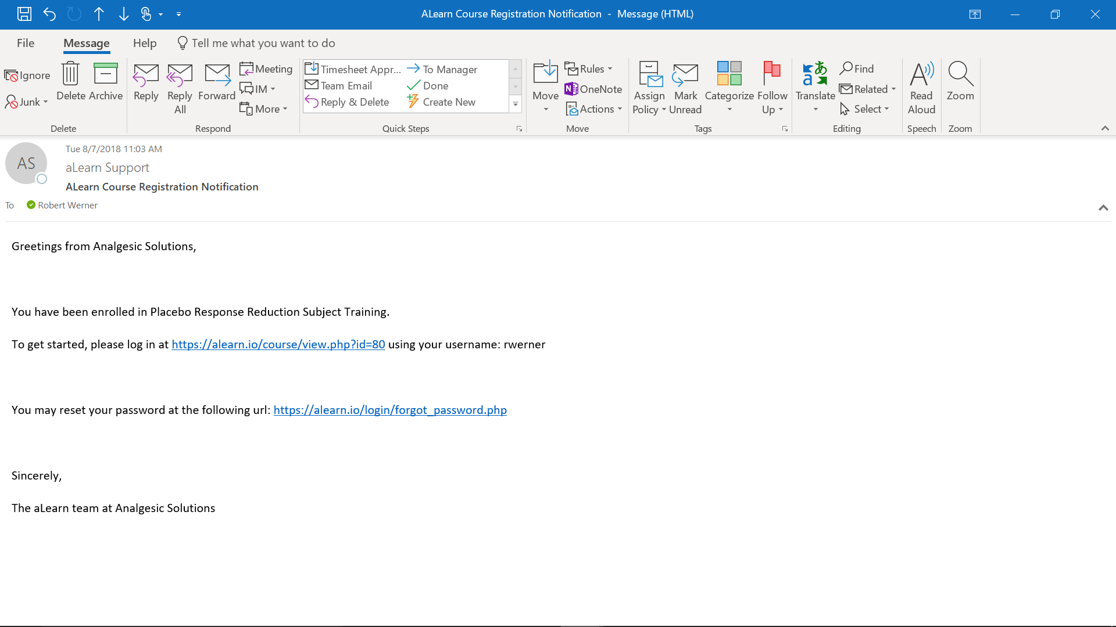
Subject Accounts
  Staff will receive a Subject Access Guide with written instructions to assist in the log-in process
  Subject accounts are pre-set
  30 accounts per site are already set up in the system for your site
  Inform Analgesic Solutions if more subject accounts need to be added
  Subjects will have login credentials
      Username = Subject ID
      Password = Study name
  Subjects will be prompted to change password
Username 1
Username 1

Slide 130
Subject Training Activities
Subject training modules are programmed to be followed in order similar to Staff training:
  Training: The training consists of two eLearnings addressing Accurate Pain Reporting and Placebo Response Reduction.
  Please note: Subjects have unlimited opportunities to review training.
  Feedback: Users are encouraged to provide feedback after completing the training. A link to our feedback survey will be accessible once the eLearning is complete.
  Certification: After completing the eLearning, the training module certificate will be accessible.
  Analgesic Solutions will provide a weekly update to the site coordinator with a list of all subjects that have completed APR/PRR trainings
  If sites need report sooner per subject visits, site coordinator can request from AS

Slide 131

Instructions to Give to Study Staff:
Before subjects are trained:
Study staff should review all training material before any subject site visits
Before subjects complete questionnaire:
Study staff should have subjects review their training material
Staff should answer any questions that the subjects may have
During the study:
Have subjects answer questionnaire in quiet place with no distractions
Study staff should NOT LEAD the subject
Study staff should NOT CORRECT the subject or ask them to change their pain report

Slide 132

Helpdesk
  Forgotten passwords for Staff and Subject
  Use “forgot your password” link on log-in page
  Contact AS using information for helpdesk provided on website
  Other technical difficulties
  alearn@analgesicsolutions.com
  Helpdesk is available 8am-6pm Eastern Time

Slide 133
Study Medication

Slide 134
Study Medication – Dose and Mode of Administration
FX006
Extended release formulation of triamcinolone acetonide (TA) in 75:25 poly (lactic-co-glycolic) acid (PLGA) microspheres.
32 mg TA, IA administered as a single 5 mL injection into the index hip OA joint under fluoroscopy guidance per injection procedure.
Supplied as a sterile, white to off-white powder
Reconstituted with diluent to form a suspension immediately prior to IA Injection
  Diluent - Isotonic, sterile aqueous solution of sodium chloride (NaCl; 0.9% w/w), carboxymethylcellulose sodium (CMC; 0.5% w/w) and polysorbate-80 (0.1% w/w)
  Supplied as a sterile liquid in a 5 mL vial with a butyl rubber stopper, aluminum seal and plastic cap
Refer to the Investigator’s Brochure (IB) for details of the physiochemical properties of FX006.
Placebo
Normal saline, sodium chloride (0.9% NaCl) solution, IA, administered as a 5 mL injection into the index hip OA joint under fluoroscopy guidance per injection procedure.

Slide 135
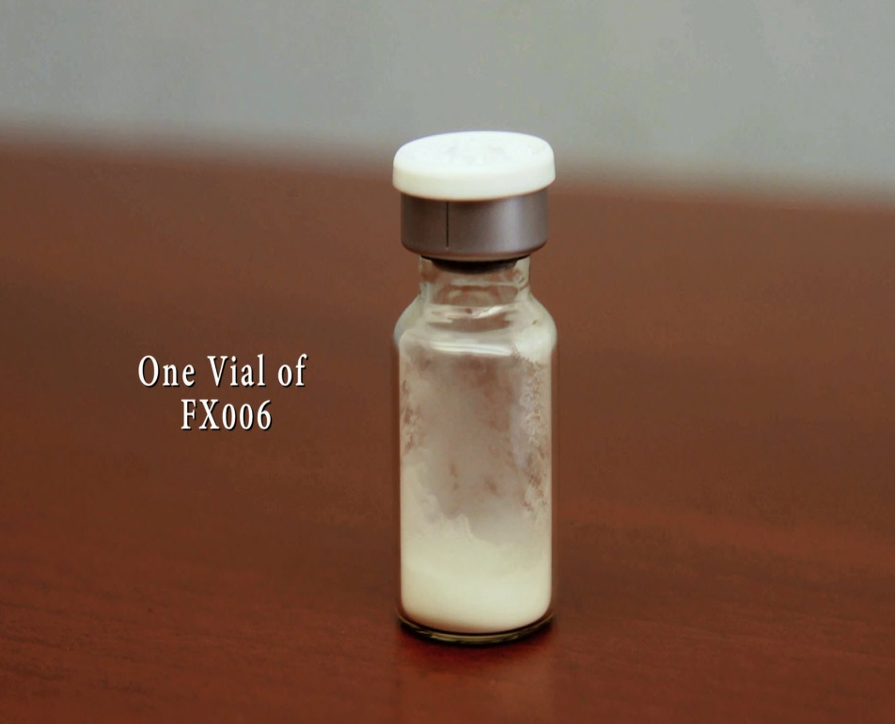
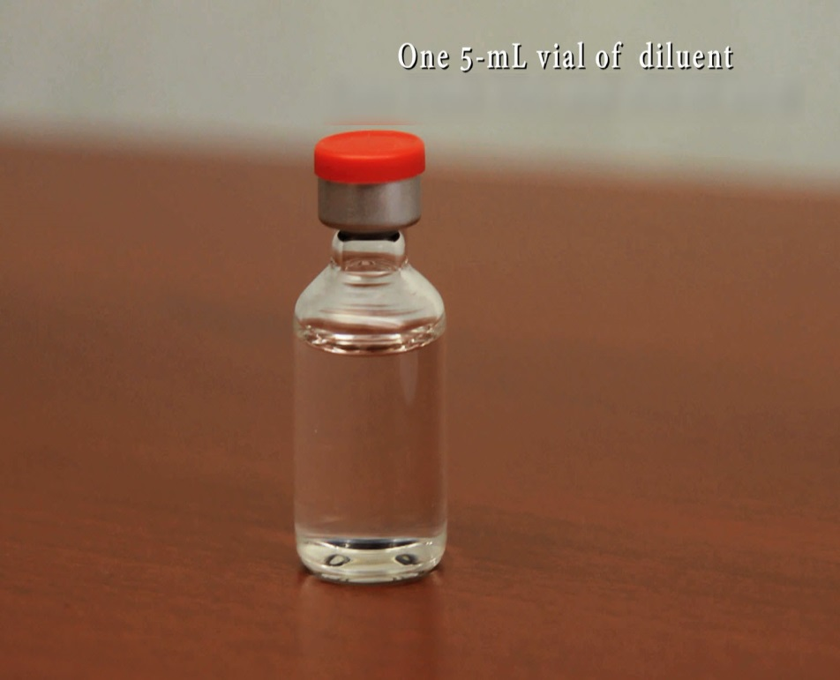
    FX006 & Diluent
One Vial of FX006
One Vial of Diluent
CONFIDENTIAL
135

Slide 136
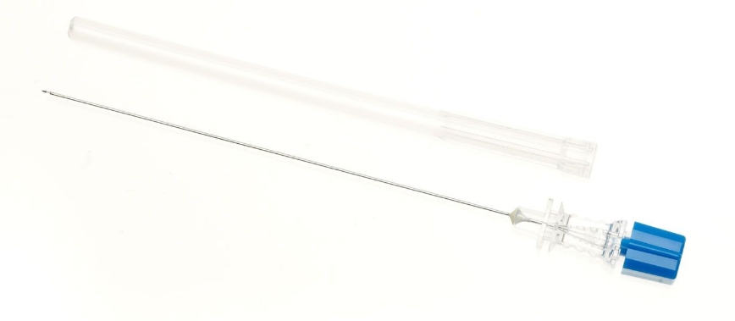
Materials for IA Injection of the Hip
For administration: 20G (or larger), 3.5 inch (90 mm)(or longer) Spinal Needle and 5 mL syringe

Slide 137
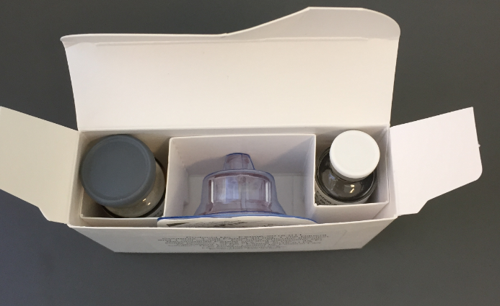
Packaging and Labeling of Study Medication
Will contain:
  one (1) vial of FX006
  one (1) vial of Diluent
  a vial adapter
Each FX006 kit will be labeled with an individual kit number
CONFIDENTIAL
137

Slide 138
Initial Drug Supply
Sites will receive a study drug supply of FX006 Packaged Kits and Placebo vials after site activation.
  There will be a threshold of kits that will trigger re-supply through the Fusion system
If there is concern re: drug supply, sites should contact the unblinded CRA to follow-up with Flexion.
Study drug orders will be processed through Fusion Drug Tracking Module
CONFIDENTIAL
138

Slide 139
Ancillary Supplies and Rescue Medication
Ancillary Supplies (needles, syringes, pad to cushion vial tapping)
Ancillary supplies will be supplied prior to site initiation visit.
If additional ancillary supplies are needed, email clinicalsupplies@flexiontherapeutics.com
  Reference FX006-2018-015 within the subject of the email
  Unblinded CRAs should be copied on any study drug order requests
Rescue Medication
Rescue medication initial supply is initiate by flexion.
An automatic resupply will be triggered when certain threshold levels are hit per site in Fusion. If additional supplies are needed, you can use the clinical supplies form.
CONFIDENTIAL
139

Slide 140
    Receipt, Dispensing, and Storage
Receipt and Dispensing
  Study medication will be acknowledged upon receipt in the Fusion Drug Tracking Module
  Study medication and supplies will be dispensed by the unblinded pharmacist/SC
  Receipt and dispensation of drug supplies will be properly documented in IP Accountability in Fusion.
  Any temperature excursions occurring on site should be documented on the excursion form in the Pharmacy Binder and placed in Quarantine in the Fusion system.
  Any temperature excursions occurring during transit to site should be documented in Fusion Drug Tracking Module by registering IP Shipment as ‘quarantine’
Storage
  All study medications will be stored in a secure area with only unblinded staff access
  FX006 kits will be stored refrigerated at 2 to 8°C.
  Placebo will be stored at room temperature

Slide 141
Accountability and Returns
Accountability
  Unblinded CRAs Complete the drug accountability in the Fusion Drug Tracking Module
  Used and unused vials should be stored until the unblinded monitor has reviewed accountability.
  Used vials should be stored with some kind of identification of what patient the vial was used for (i.e. write pt ID on vial, store in a ziploc bag labelled with pt ID).
Returns
  All study medications will be returned to the Sponsor.
  Return of study medications will be properly documented.
  Return form will be included in the shipment and also scanned to clinicalsupplies@flexiontherapeutics.com, copying your Unblinded CRA and Unblinded LCRA

Slide 142
IP Reconstitution
FX006-2018-015 SIV Training

Slide 143
Drug Prep Video

Slide 144
IP Preparation Instructions
Please see DH104 – Dose Preparation Procedure for FX006.

Slide 145
IP Administration Procedure
IA administration into the hip joint
  Sterile technique will be used
  Injection will be performed by the assigned unblinded injector. (The injector may choose the numbing agent to be used based on standard of care, if needed)
  A 20 gauge or larger, 3.5 inch needle or longer is to be used for injection
Either 5 mL of the reconstituted FX006 or 5 mL of normal saline will be injected into the index hip joint.
Details on how to prepare FX006 will be in the Pharmacy Manual
Reconstitution process should only be visualized by the assigned independent injector

Slide 146
IP Administration Procedure (Continued)
Injection into the hip joint will be done with fluoroscopy guidance by the assigned injector.
The injector may choose the position of the hip (e.g., supine position with lower extremity internally rotated) and the approach for injection (e.g., anterior.)
Aspiration must be attempted prior to all injections. If effusion is detected by fluoroscopy, withdraw to near dryness prior to injection

Slide 147
    FX006 Preparation
  Use Sterile Technique throughout the dose preparation procedure
  The site’s standard of care for sterile technique should be applied Elements of sterile technique may include:
    Use of a clean, dedicated area
    Sterile hand hygiene (e.g., alcohol-based, chlorhexidine)
    Use of medical-grade nonsterile or sterile gloves
  Materials Needed:
  One (1) vial of FX006
  One (1) 5-mL vial of diluent
  Alcohol pads
  One (1) vial adapter
  Three (3) 20-gauge or larger needles
  sponsor has provided 20-gauge, 3 ½” length needles
  One (1) 5-mL syringe
CONFIDENTIAL
147

Slide 148
SAE Reporting Process and Notifications
FX006-2018-015 SIV Training

Slide 149
Adverse Events
An Adverse Event is any untoward medical occurrence in a patient/subject administered a pharmaceutical product and that does not necessarily have a causal relationship with this treatment. This includes:
Any unfavorable and unintended sign (including an abnormal laboratory finding), symptom, or disease temporally associated with the use of a investigational product, whether or not related to the product
Any clinically significant* abnormality found on an ECG, laboratory test or physical examination
Any worsening of a preexisting condition, which is temporally associated with the use of the product
* Per assessment of the Investigator (not a standard out of range value)

Slide 150
Serious Adverse Events (SAE)
Serious Adverse Event (SAE): Any AE that results in any of the following outcomes:
Results in death
Is life-threatening
  substantial risk of death at the time of the event; it does not refer to an event which hypothetically might have caused death if it were more severe.
In-patient hospitalization or prolongation of existing hospitalization:
  Hospitalization means greater than 24-hour inpatient admission
  Prolongation of an existing hospitalization
  A hospitalization for an elective or pre-planned procedure or a routinely scheduled treatment is not an SAE by this criterion because a “procedure” or a “treatment” is not an untoward medical occurrence. The condition should be treated as medical history.
  If complications arise during the planned hospitalization or procedure or the patient experiences an AE during the planned hospitalization or procedure, it must be reported as an AE.
Persistent or significant disability / incapacity
Congenital anomaly or birth defect
Important medical event: event that may not be immediately life-threatening or result in death or hospitalization but may jeopardize the patient or may require intervention to prevent one of the outcomes listed in the definition above.

Slide 151

Adverse Events - Severity
Each adverse event should be evaluated for severity or intensity.
This is not the same as “serious,” which is based on patient/event outcome or action criteria usually associated with events that pose a threat to a patient’s life or functioning.
The severity of AEs will be assessed according to the following definitions:
Mild | the AE is noticeable to the patient and/or the Investigator, but does not interfere with routine activity.
Moderate | the AE interferes with routine activity, but responds to symptomatic therapy or rest.
Severe | the AE significantly limits the patient’s ability to perform routine activities despite symptomatic therapy

Slide 152
Adverse Events – Relationship to Drug
A medically-qualified Investigator must assess the relationship of any AE (including SAEs) to the use of the investigational product, as related or not related, based on clinical judgment and using all available information, and may include consideration of the following factors:
Possible alternative causes of the AE
The temporal association between drug exposure and onset of the AE.
Is the AE consistent with known actions or toxicity of the investigational product.
Not Related: An AE is not associated with study medication if: Temporal relationship is lacking (e.g., the event did not occur within a reasonable time frame following administration of the study medication); or Other causative factors more likely explain the event (e.g., a pre-existing condition, other concomitant treatments).
Related: An AE is attributed to the study medication if: There is a positive temporal relationship (e.g., the event occurred within a reasonable time frame following administration of study medication); and The AE is more likely explained by the investigational product than by another cause (i.e., the AE shows a pattern consistent with previous knowledge of the investigational product or the class of the investigational product).

Slide 153
AE timing
Study drug
administration
Last visit
Prior to study drug administration | After study drug administration
Preexisting conditions Medical/surgical history | Adverse events Serious adverse events
Events that started before study drug administration and continue should be listed as ongoing medical history (ex: hyperglycemia, hip pain, headaches, etc)
Events that start before study drug administration but get worse after study drug administration, should be evaluated by the Investigator as an AE. AE onset date would be the date the event got worse than previously experienced. (example: patient has a history of getting tension headaches a couple of times a week. After drug, she experiences the worst headache of her life.)

Slide 154
SAE Reporting
When site personnel learn of an (S)AE, they must bring it to the attention of the Investigator, who then needs to review the information available and assess if it is an AE and then for seriousness and relationship.
If determined to be an SAE, it must be reported within 24 hours
Process:
The PI or designee must log into the EDC system and complete the SAE Report form within 24 hours of first becoming aware of the SAE. If the coordinator enters the SAE information into EDC, the PI must sign off on it.
  The SAE will automatically be reported to Flexion electronically.
  If the EDC system is not available at the time, a paper form is available for use (email) but then the SAE must be entered into EDC once the system is available again.
    Email paper reports to safety@flexiontherapeutics.com
SAE follow-up information must be reported to Flexion within 24 hours of receipt by the Investigator by entering new information into the electronic SAE form.

Slide 155
Offline forms available
SAE form:
Use only if EDC system is down.
Complete as much as is available
Complete, have PI sign and send to safety@flexiontherapeutics.com
When EDC system is working, enter the SAE into EDC.

Slide 156
Offline forms
Pregnancy report form:
For use when a patient or female partner of a male subject becomes pregnant during the study
Only available offline (not in EDC)
Should be completed, signed by PI, and sent within 24 hours to safety@flexiontherapeutics.com
Investigator should follow the patient until pregnancy is completed, then update the form and send in, even if after the end of the study.
If baby is born with a congenital abnormality, that is an SAE.

