Slide 1
Desktop Agent & Portal Training
Judi / / Imaging

Slide 2
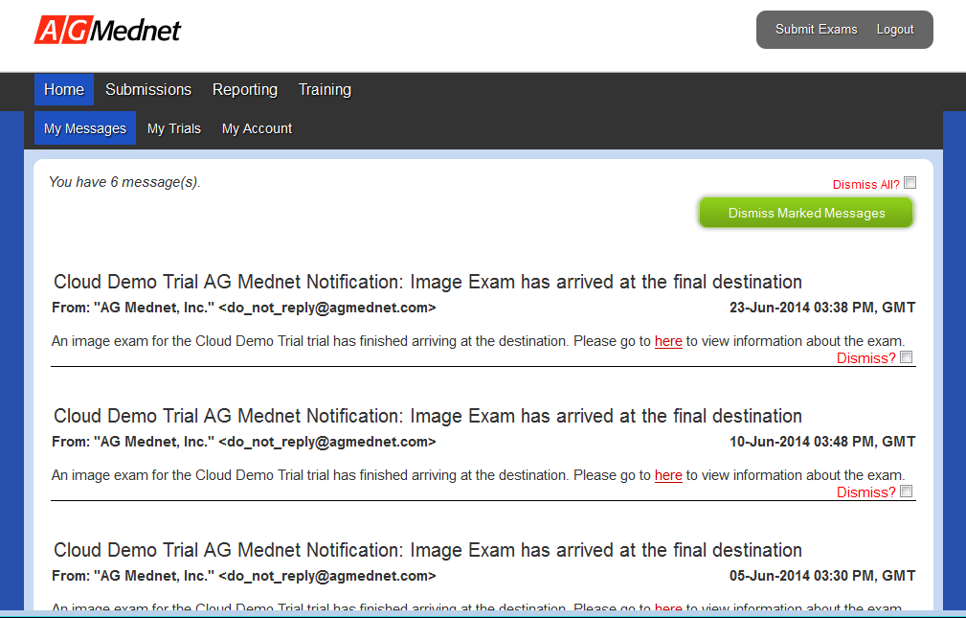
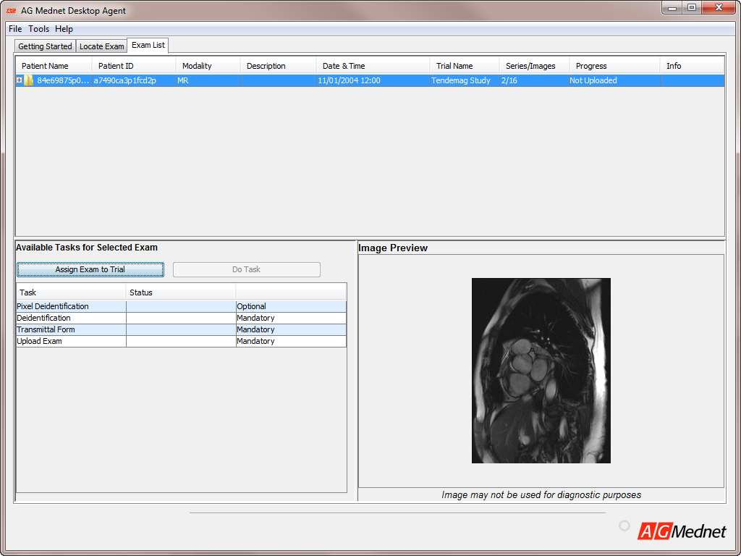
Access to Judi // Imaging
Comprised of two parts:
The AG Mednet Desktop Agent enables Site Senders to de-identify and compliantly send their study exams to the core lab or sponsor.
The Judi Portal is where everyone registers for their AG Mednet account. This includes creating your own username and password. https://portal.agmednet.net

Slide 3
Getting Started
(Basic Requirements)
Computer/Operating System
Windows 7 or newer is required.
Disk Space/Memory
Sufficient disk space to store temporary local copies of image exams;
Internet Access and Compatible Browser
Java version 8
AG Mednet Desktop Agent
Required: Java ver. 8 installed on your Mac or PC to use AG Mednet.
The Desktop Agent may be launched from the Judi Portal, or double-click the “AG Mednet Desktop Agent” icon on your computer desktop.
Mac OS X ver. 10.10 (Yosemite), 10.11 (El Capitan) or above.
Minimum of 1 GB of memory.
You will be prompted to download Java if it is not already installed.
Internet Explorer Version 11, Mozilla Firefox Version 44.x, Google Chrome Version 48.x (Windows only), Apple Safari version 9.x or newer (Mac only).
Java 7 Update 80 is also supported

Slide 4

Overview
Submit An Image Exam
  Complete account authorization
  Register for an account on the AG Mednet Portal
  Launch the Desktop Agent and Log-in
  Submit an exam
    Import an image exam
    Review images (optional)
    Assign the exam to the trial
    De-identify the Pixel Data
    Complete SQC
    Clinical Trials Module
    Complete the Data Transmittal Form
    De-identify the DICOM data
    Upload the exam
    Confirm successful exam submission
  Navigate and customize the AG Mednet Portal

Slide 5
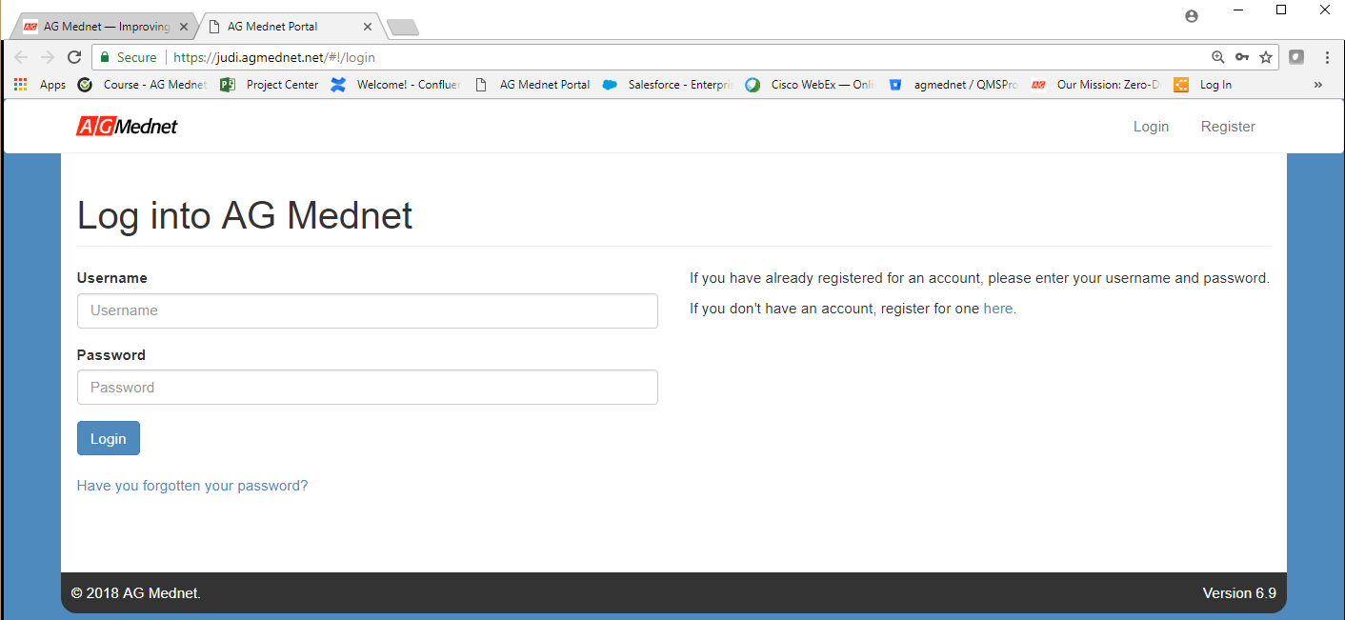
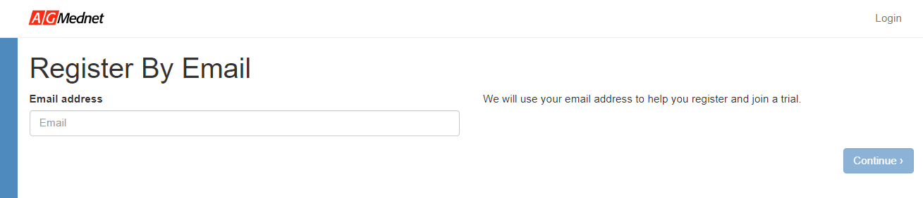
Step 1:
Complete Account Authorization
Visit the Portal: https://portal.agmednet.net and Select register for one here (1) to create a new account. Or enter your Username and password to sign in.
Enter your e-mail address into the system to proceed with account authorization (2).
1
2

Slide 6
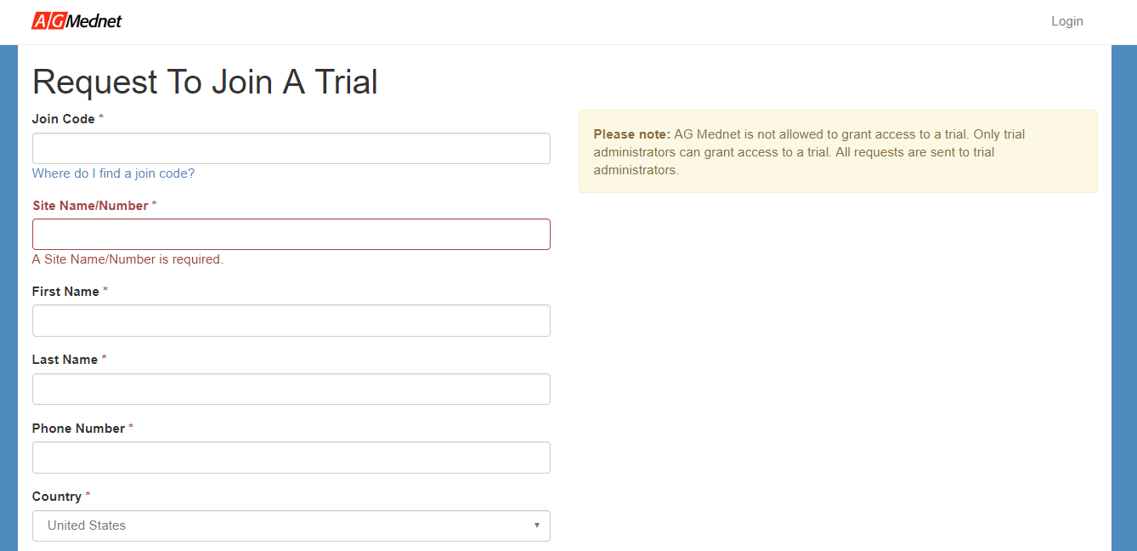
Step 1:
Complete Account Authorization
If you have already received an invitation email, skip to the next slide.
Enter the Join Code (SZ6XL5Y) as well as your Site Name/Number, First Name, Last Name, Phone Number, and Country. You may also enter Additional Comments if desired. Click Submit Request to notify the Trial Admin, who can then issue you an invitation. Please note that AG Mednet employees are not authorized to give you access to a study.
Note: Contact the trial admin to request access to the study. AG Mednet employees are not authorized to grant access.

Slide 7
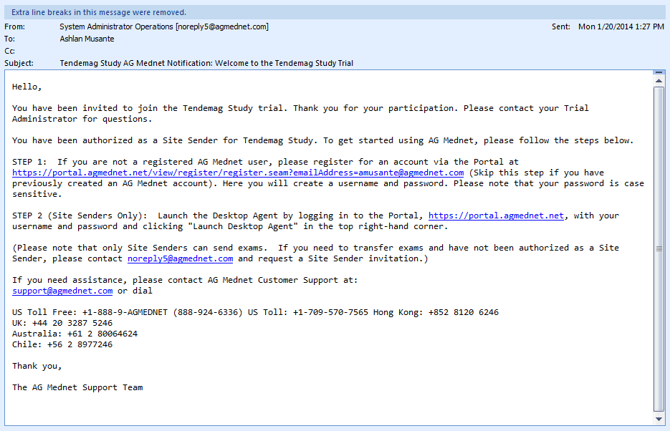
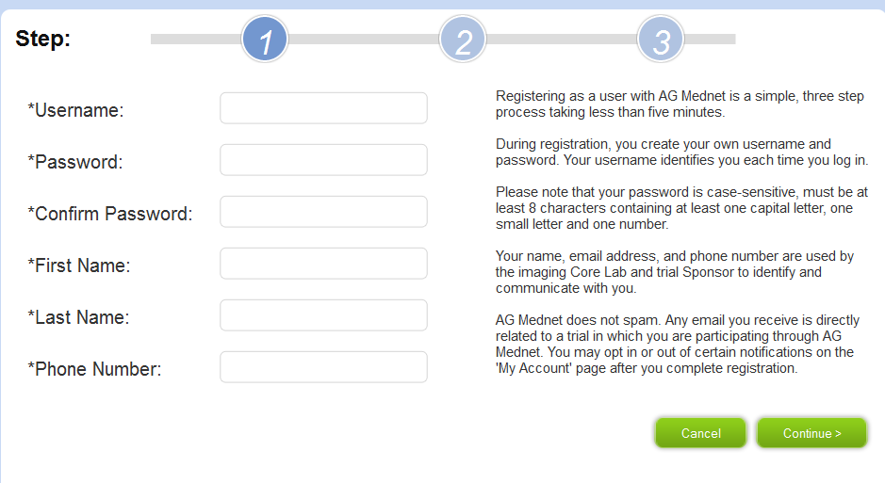
Step 2:
Registration
If you have received an invitation email (right) you are authorized to send exams to the study. After entering your e-mail address into the Judi Portal, you will automatically progress to account registration (below). Enter all required fields to continue.
Note: Contact the trial admin to request access to the study. AG Mednet employees are not authorized to grant access.

Slide 8
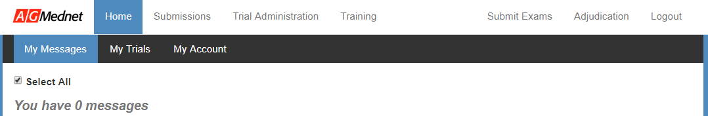
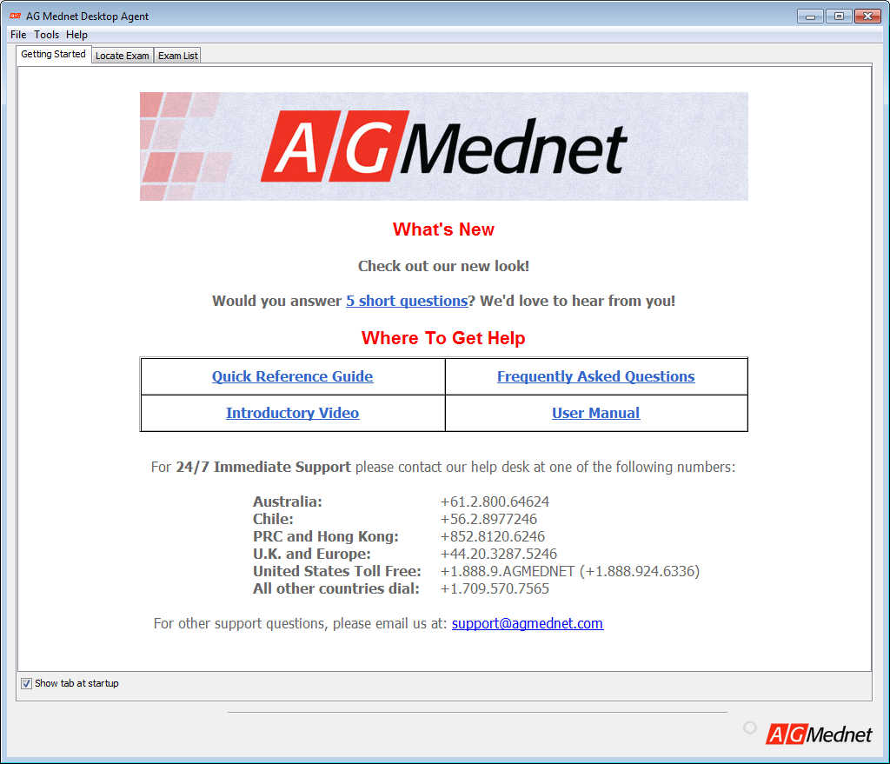
Step 3
Launch the Desktop Agent and login
1
2
Visit the Portal at https://portal.agmednet.net and log in using your credentials. Select the Submit Exams link and download the file. (1)
If launching the Desktop Agent for the first time, the terms of use agreement will appear. After reading the agreement, the Getting Started page of the Desktop Agent will open. (2)

Slide 9
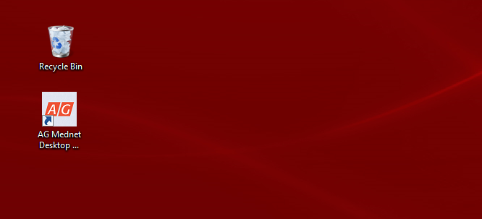
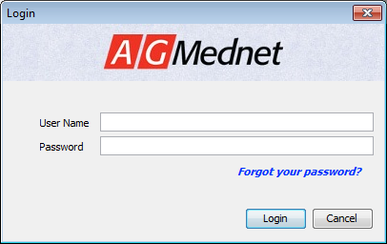
Step 3
Launch the Desktop Agent and login
3
After the initial launch, the Desktop Agent may be opened using the icon on your computer desktop (3) using the same login credentials. (4)
4

Slide 10
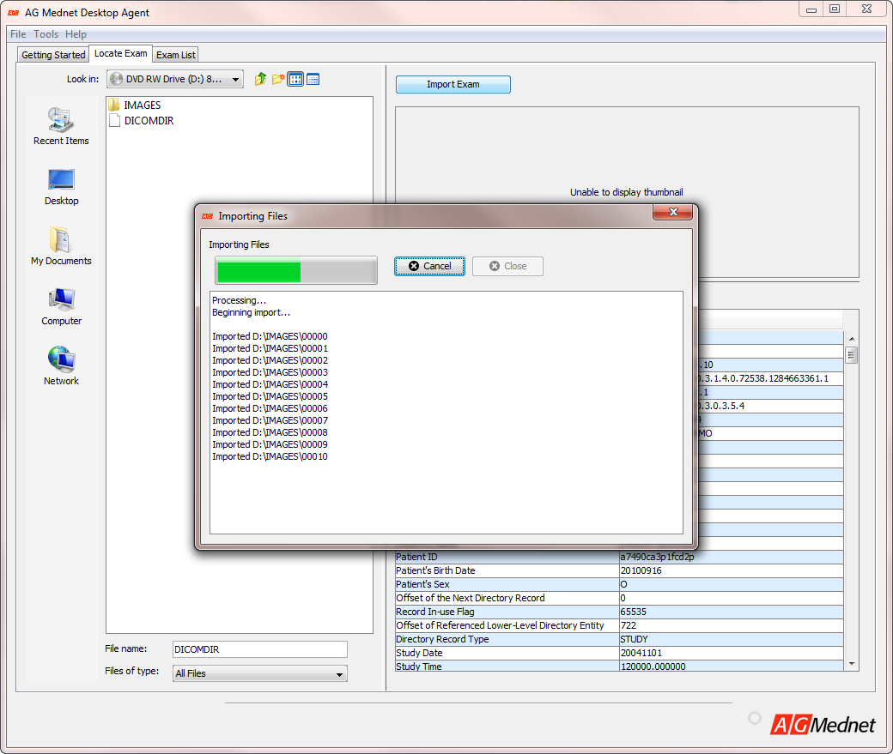
Step 4a:
Import the Image Exam from the Source File (e.g. CD, USB, PACS)
Select the Locate Exam tab (1). Use the buttons (2) to navigate your computer to the exam folder. Select the DICOM formatted images that you would like to upload, or select the DICOMDIR file to import the entire exam. Click Import Exam (3) to bring the files into the Desktop Agent.
1
3
2

Slide 11
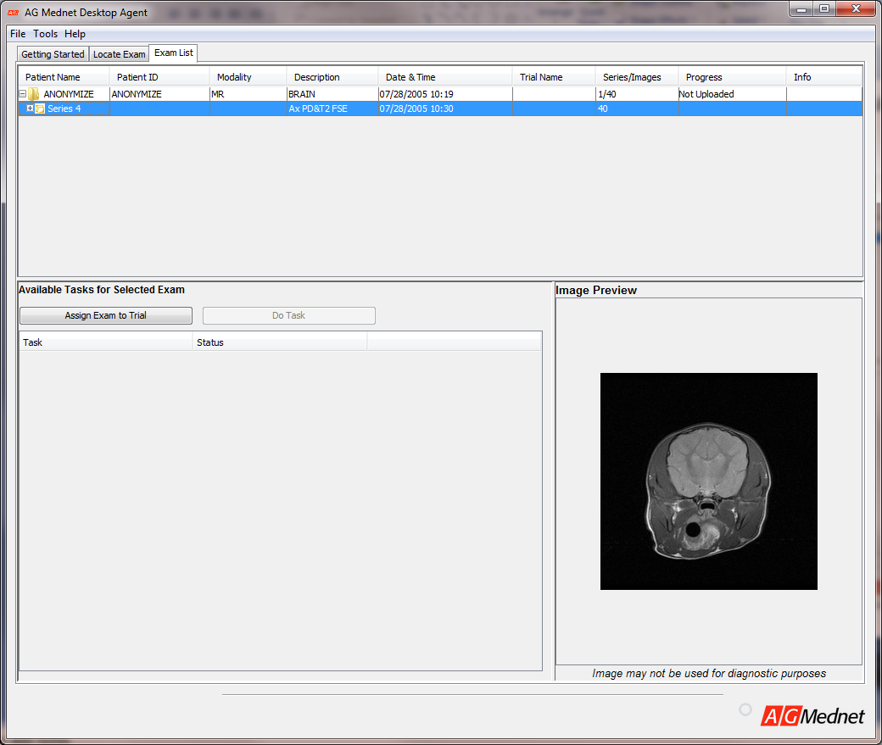
Step 4b
Review Images
1
Select the Exam List tab (1). Select the “+” sign next to the exam folder to show the series. (2)
Select the “+” sign next to the series to show the images (i.e. Instances) in that series. (3)
Select the image to preview in the lower right panel. The exam may include structured reports as part of the image that contain only PHI data. Right click the image to delete. You may delete single instances/ images, series, or the entire exam. (4)
2
Tip: Any images/sequences that are not required by the protocol can be deleted from the study to avoid long upload times and sending unnecessary data.

Slide 12
Step 4b
Review Images
1
Select the Exam List tab (1). Select the “+” sign next to the exam folder to show the series. (2)
Select the “+” sign next to the series to show the images (i.e. Instances) in that series. (3)
Select the image to preview in the lower right panel. The exam may include structured reports as part of the image that contain only PHI data. Right click the image to delete. You may delete single instances/ images, series, or the entire exam. (4)
2
Tip: Any images/sequences that are not required by the protocol can be deleted from the study to avoid long upload times and sending unnecessary data.

Slide 13
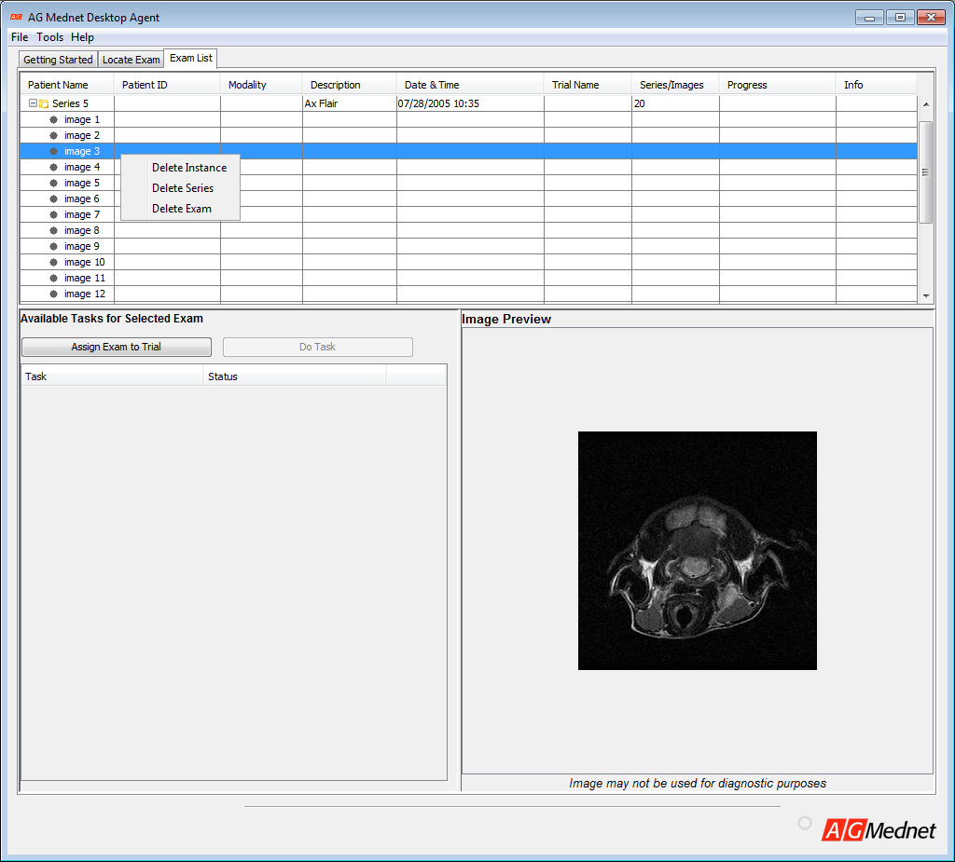
Step 4b
Review Images
Select the Exam List tab (1). Select the “+” sign next to the exam folder to show the series. (2)
Select the “+” sign next to the series to show the images (i.e. Instances) in that series. (3)
Select the image to preview in the lower right panel. The exam may include structured reports as part of the image that contain only PHI data. Right click the image to delete. You may delete single instances/ images, series, or the entire exam. (4)
4
Tip: Any images/sequences that are not required by the protocol can be deleted from the study to avoid long upload times and sending unnecessary data.

Slide 14
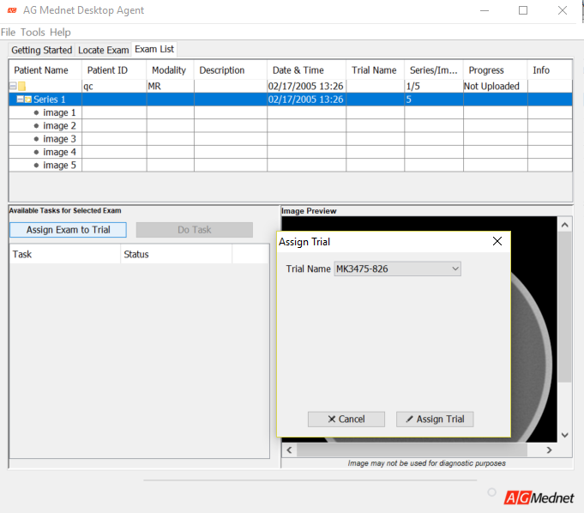
Step 4c
Assign Image Exam to the Trial
Select the exam from the available exams (1).
Select Assign Exam to Trial (2).
From the window that opens, select the trial the exam should be assigned to and select Assign Trial (3)
1
2
3

Slide 15
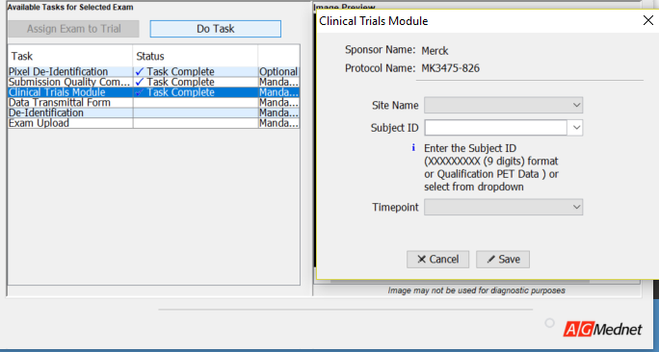
Step 4f
Clinical Trials Module
Select Clinical Trials Module (1). Select the Do Task button. (2)
Select the correct values from the dropdown lists in the Site Name, Subject ID (you may need to type the Subject ID if it is not yet available in the dropdown list), and Timepoint fields. Select the Save button (3). A progress window will appear and alert you when the process is complete.
2
1
3

Slide 16
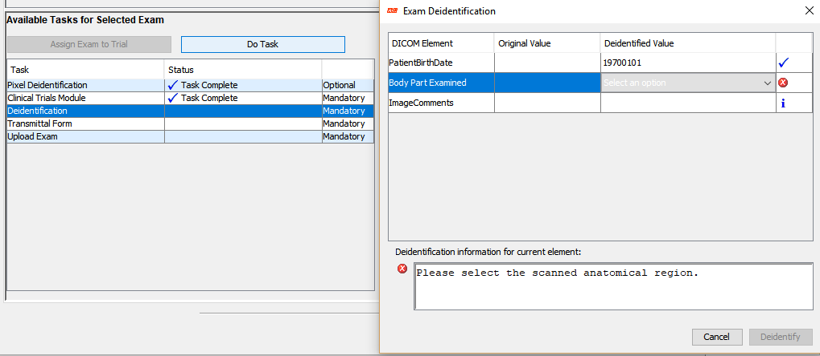
Step 4g
DICOM De-Identification
2
Select De-Identification (1). Select Do Task button. (2)
Enter the required De-identification Value per the guidance text.
Select De-Identify (3)
1
3

Slide 17
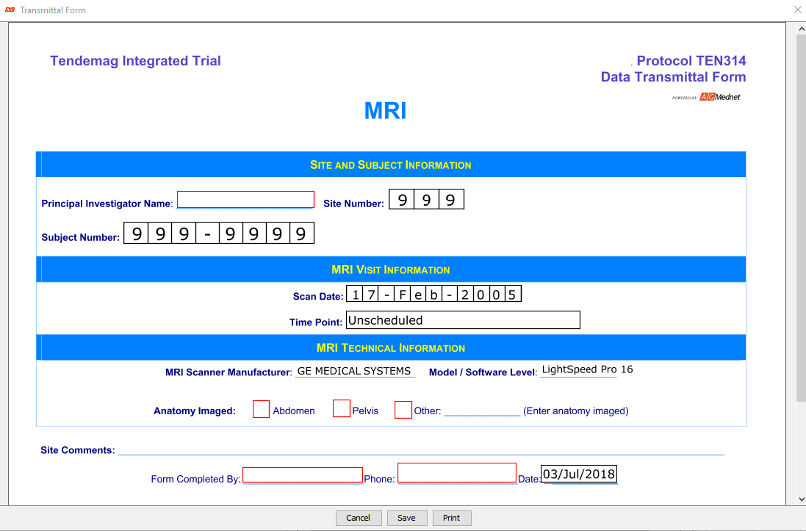
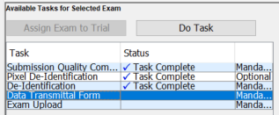
Step 4h
Complete the Transmittal Form - Echo
Select Transmittal Form (1). Select the Do Task button. (2)
Complete the form. Including any comments (3). (Note: not all fields are mandatory.)
Select the Print button to print a copy for your records. (4)
Complete by selecting the Save button (5). A window will alert you when saving is complete.
3
2
5
4
1

Slide 18
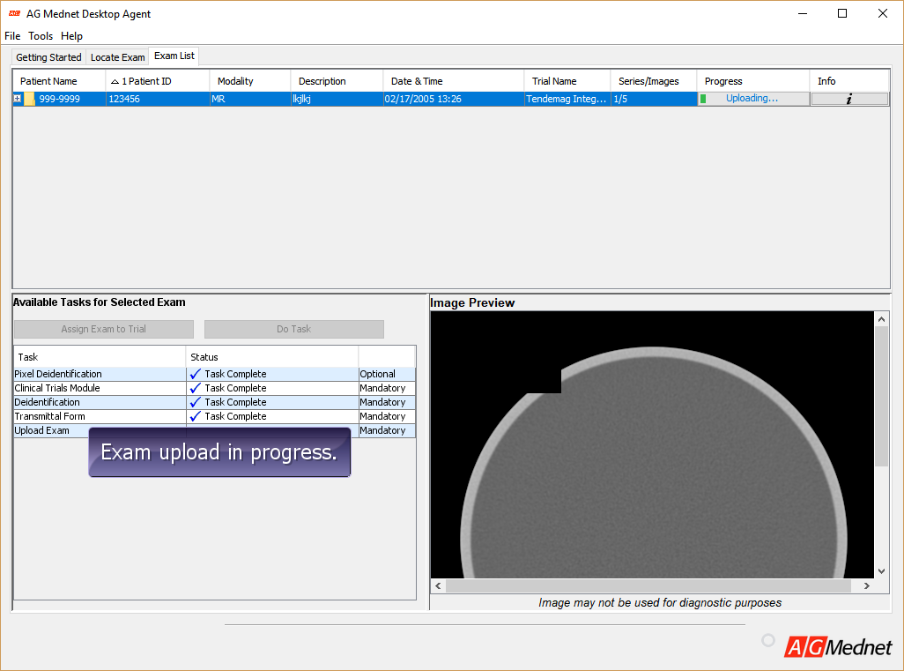
Step 4i
Upload the Image Exam
3
4
Select Upload Exam (1), then Select the Do Task button. (2)
A progress bar will appear in the exam list (3). Do not exit the Desktop Agent during the upload or exam transfer will be paused.
Select the 'i' button under Info to view detailed information about the exam upload progress. (4)
2
1

Slide 19
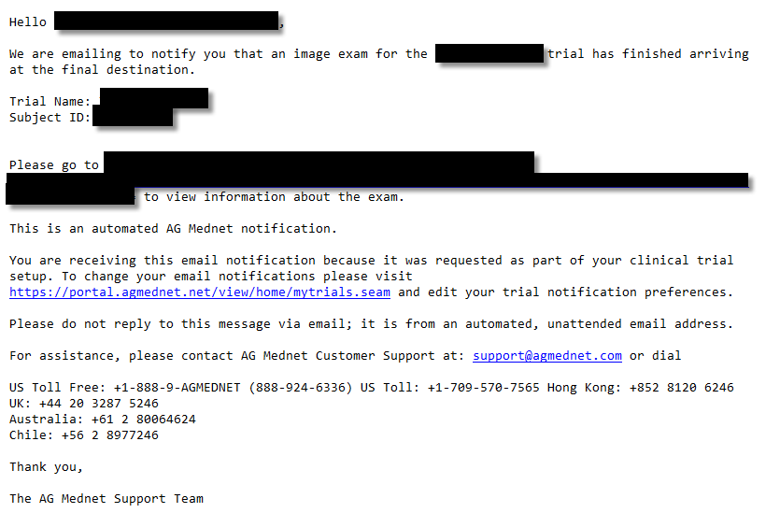
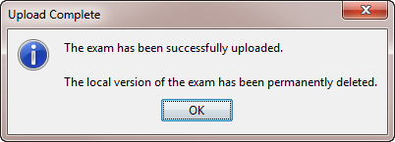
Step 4j
Confirm Successful Exam Submission
A pop-up window in the Desktop Agent will appear, notifying you that the exam has been successfully uploaded.
A confirmation email will also be sent when the exam has been successfully uploaded. The e-mail includes a link to view the submission details on the AG Mednet Portal.

Slide 20
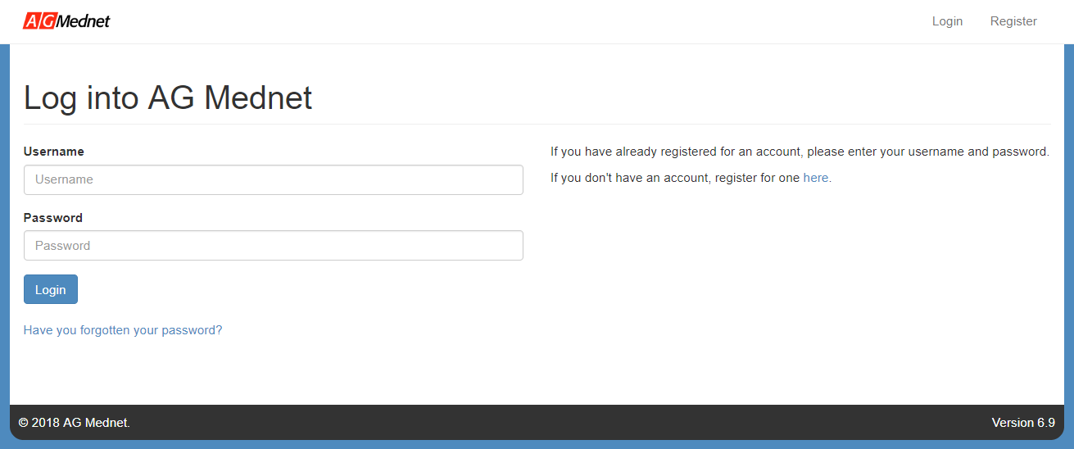
Step 5
Navigate and Customize the AG Mednet Portal
Visit the Portal at https://portal.agmednet.net to log in (1). The Home tab (2) routes to My Messages, My Trials, and My Account sub-tabs. The Submissions tab (3) allows you to view your Submission List. The Training tab (4) is where you will gain access to our multi-lingual training videos and User Guide, Quick Reference and FAQ. You may also select Submit Exams to launch the Desktop Agent (5) or select Logout to exit (6).
1
2
3
4
5
6

Slide 21
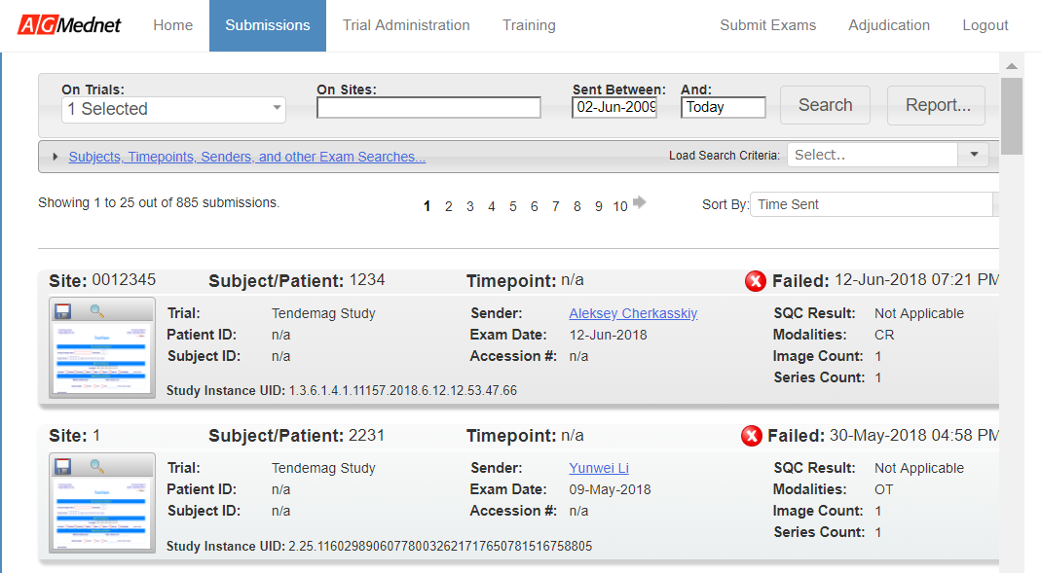
Submissions List: Overview
1
Note: This view is relevant after you have submitted data from the AG Mednet Desktop Agent.
To view current submission list Select the Submissions tab (1).

Slide 22
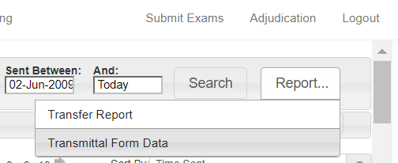
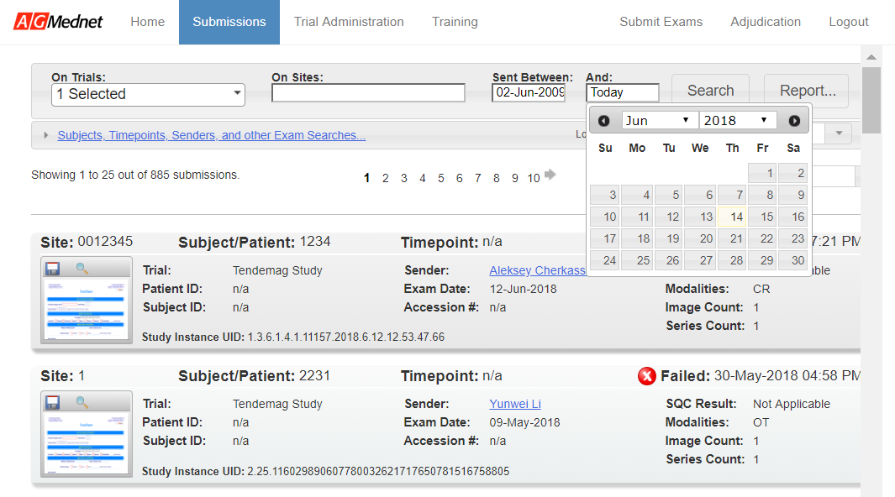
Submissions List
Date Range and Reporting
Select a date range for the Submission List by setting the Sent Between range. Indicate the “from” (1) and “to” dates (2) using the calendar feature. Select “Search” to apply the filter (3). The Submission List will re-populate with the indicated date range.
4
1
2
3
Select the Report button to view two different reports (4). The Transfer Report will show you details about exam submissions. The Transmittal Form Data report summarizes data from the transmittal forms. The data displayed is relevant to the current search.

Slide 23
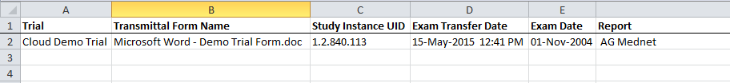
Reporting
Below are samples of the two reports, Transfer Report (1) and Data Transmittal Form Report. (2)
1
2

Slide 24
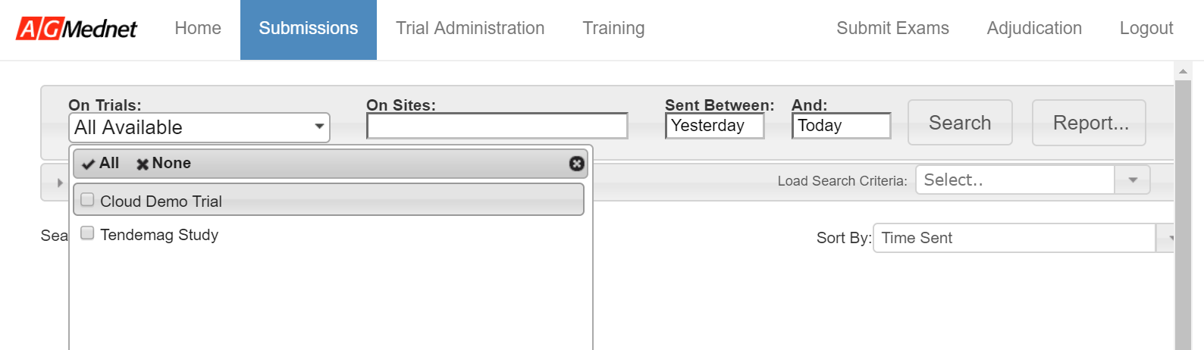
Submissions List
Trial and Site Sorting
3
1
2
Limit the content of the Submission List to a specific trial (1) or site (2). Apply your selection by pressing “Search” (3). The Submission List will re-populate with the desired Trial and Site information.

Slide 25
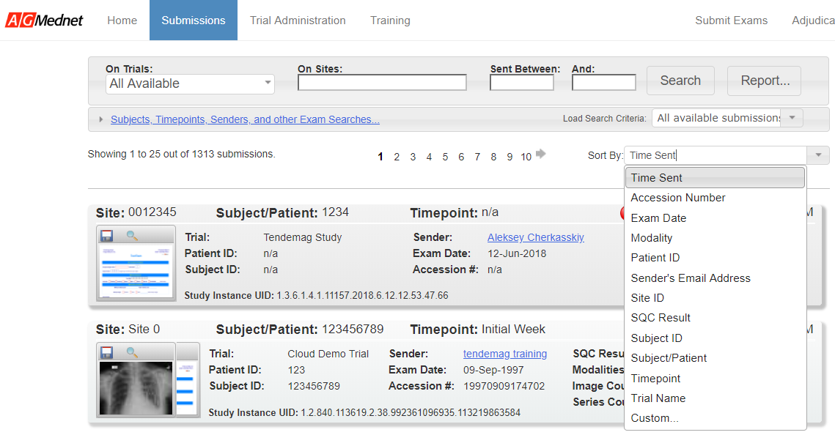
Submissions List
Sort
1
To sort Submission List, Select the arrow next to the Sort By dropdown menu (1). After making a selection, the Submission List will automatically update.

Slide 26
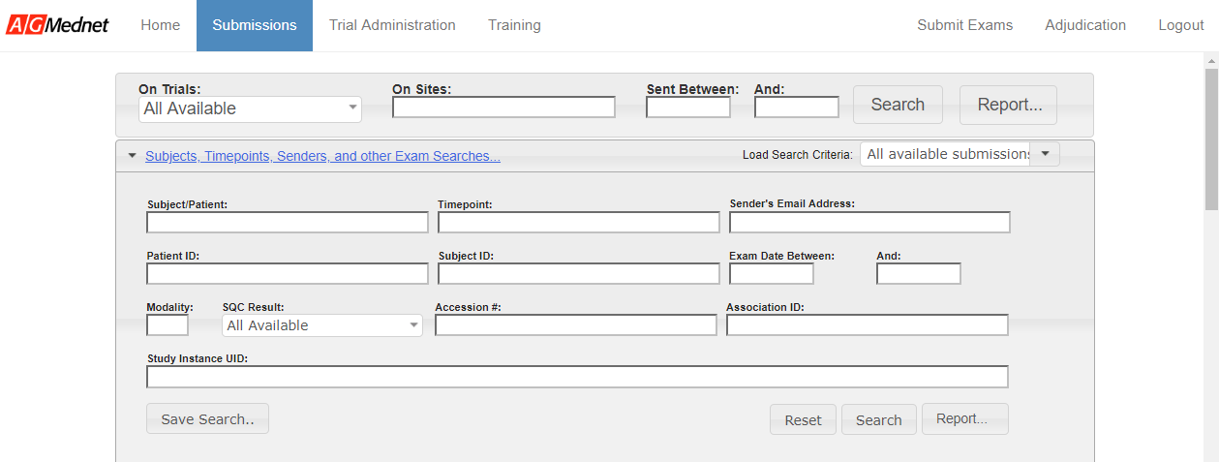
Submissions List
Advanced Search
7
Select “Subjects, Timepoints, Senders and other Exam Searches” to access the Advanced Search feature (1). Enter the desired search criteria into the query fields (2). Press “Reset” (3) to clear the fields or “Search” (4) to complete the query. The Submission List will re-populate per the entered filter criteria. Press “Report” (5) to generate a report using the selected data. Press “Save Search” (6) to save your search. Your search will appear in the “Load Search Criteria” dropdown list. (7)
1
2
6
3
4
5

Slide 27
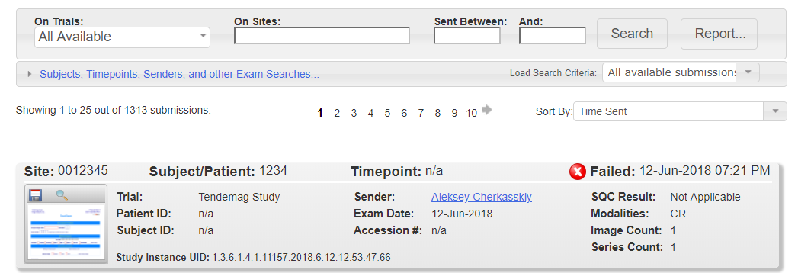
Submissions List
Transmittal Form
Select the icons to save/print (1) or view (2) the data transmittal form.
1
2

Slide 28
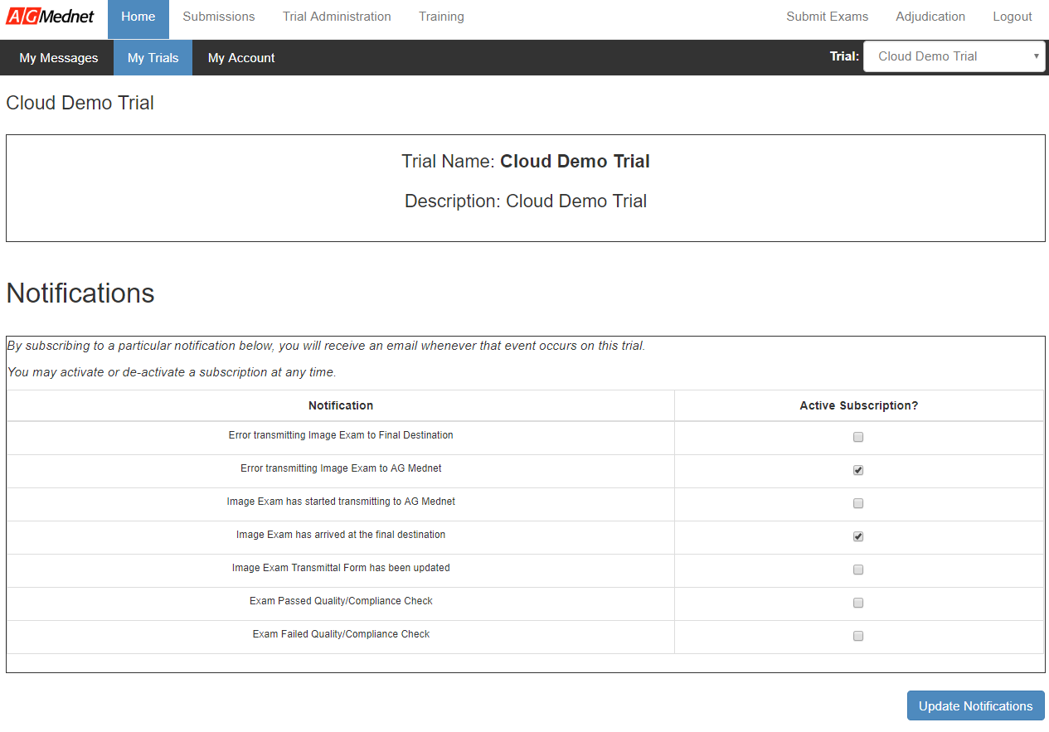
Email Notifications
1a
1b
Select Home tab (1a) and My Trials sub-tab (1b).
Confirm the trial in the dropdown menu in the upper-right corner. (2)
Notifications are listed under trial description. Select desired notifications in the Active Subscription (3a) column and click Updated Notifications to save updated preferences. (3b)
Note: All users are automatically signed up for the “Error transmitting…” and “Image Exam…Final Destination” notifications.
2
3a
3b

Slide 29
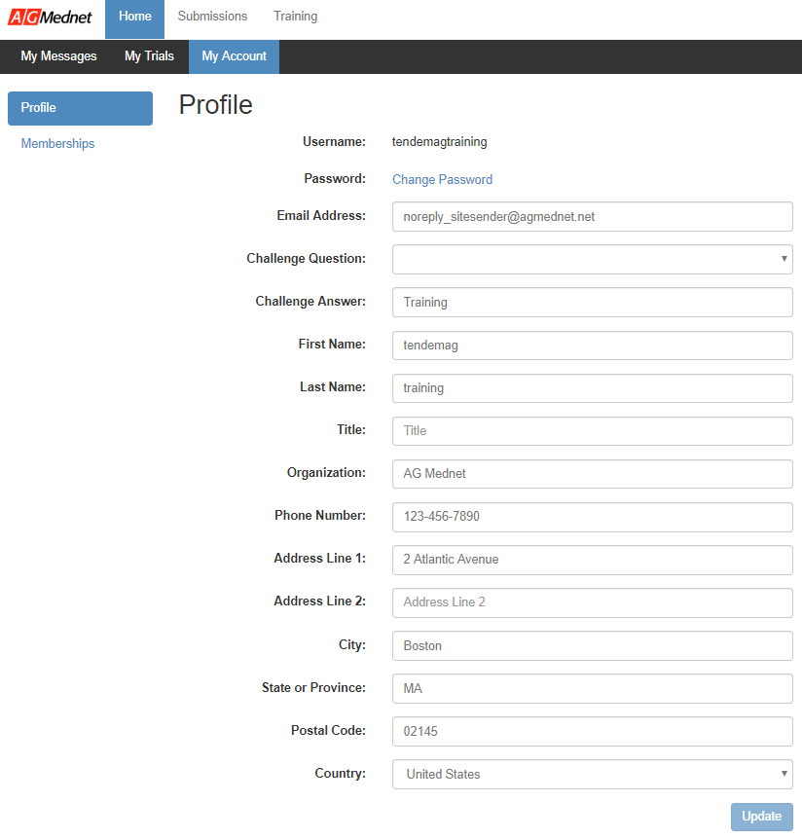
Modify Account / Password Settings
1a
1b
Select Home tab (1a) and My Account sub-tab. (1b)
Change any pertinent information as required. (2)
Click Update to save updated preferences. (3)
2
3

Slide 30
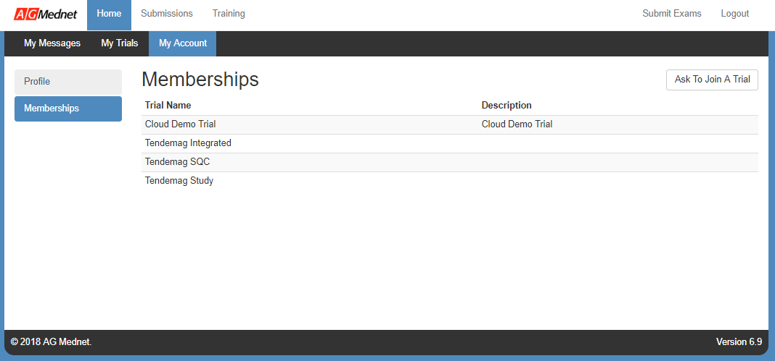
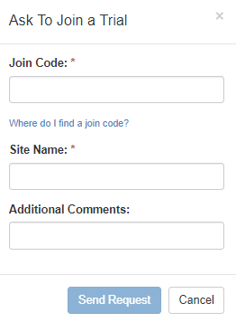
Request to Join an Additional Trial
1a
Select Home tab (1a) and My Account sub-tab. (1b)
Select Membership. (2)
Click Ask To Join Trial. (3)
Enter the Join Code for the trial and your Site Name, and Additional Comments. (4)
Click Send Request. (5)
1b
3
2
4
5

Slide 31
Support & Help
The AG Mednet Global Help Desk is available 24x7x365 to support users worldwide, in dozens of languages
Our call center fields the call, initiates troubleshooting, and assigns an AG Mednet technical resource
We provide toll-free numbers from 26 countries, and additional countries can be added upon request
Urgent requests:
  US Toll Free: +1-888-9-AGMEDNET (888-924-6336)
  All toll-free numbers can be found on the AG Mednet website: http://www.agmednet.com/customer-support/
Routine or non-urgent requests:
  Email contact: support@agmednet.com (response within 1 business day)
Should translators be needed, AG Mednet will conference in multilingual support
AG Mednet recommends instructing end users to contact Support directly
If end users do not communicate directly with AG Mednet, cases will take much longer to resolve and can reduce satisfaction and adoption

